Slide 1
Performing an Amendment and Sending Prior Notices in BTOTS
By: Layne Koyle Jan. 23 2017

Slide 2
Sending a Prior in BTOTS

Slide 3
Steps to Sending an Electronic Prior Notice
First We Must Ensure that a Parent/Guardian Email address is
entered into BTOTS. (see Parent Portal training for details).
On the bottom right side of the summary tab click on link for New Prior Notice”
Fill Out the designated information on the prior notice including proposed date, time, reason for visit, and the providers that will be attending.
Remember to hit SAVE at the bottom in order for the parents to receive it via email. (You can check the parent portal to see if the prior notice has been viewed)

Slide 4
Service Amendment vs data change
An Amendment is a change to an already enrolled child’s IFSP. It is a change that is NOT completed at the IFSP or periodic review/AKA 6-month review
An amendment starts a new service, changes or ends a current service. It is when the official change is made and parents agree to it. When we used to make these official changes on paper, data entry would then enter them as adding IFSP service, NOT as an amendment.
If this change is to fix an error on a current service, it is a data entry error, NOT an amendment.
It requires 3 things: PWN, IFSP change (What outcome is being addressed or is a new one added? What service will address the outcome?), Parent Signature
Lets try it!

Slide 5
Easy as Pie!
Contact the data entry clerk for further questions or Sue or Marla for clarifications.
Practice on the Training Site:
https://btots.mdsc.com/
Password: trainMMYY

Slide 6
Performing an Amendment
After selecting the child you are working with in BTOTS, click on the IFSP tab and select the most recent IFSP. Then, select the blue “add IFSP amendment” link in the bottom right corner.
2. Next enter the date for the amendment, the date for the prior notice, and the date the parents agree to the amendment.
3. Finally, add the appropriate change dates, add dates, end dates, and/or frequency, duration, or intensity changes as necessary. Notice the separate “Add New Service” tab.

Slide 7
Adding a New Service
The Change Current Services screen comes up first because it needs to be done first. BTOTS won’t let you go back to change or end a service after adding a new service until the next day.
Add the amendment date, prior notice date and date consent for service was done. Then make the changes or end service.

Slide 8
Adding a New Service
Click 1st
After selecting “Add new Service” choose either the service type or class type from the drop-down menu.
Confirm the start date and estimated duration of time that the service will be on the IFSP (generally 12 mo or less).
Enter the frequency, duration, and length of time for the service, as well as the service location and provider from the drop-down. If the service is outside of the natural environment a justification is required.
Enter a justification for a service outside of the natural environment.
Click 2nd
Don’t forget to click save!

Slide 9
Changing a Service Provider
Changing a service provider for a service IS NOT the same as an amendment. It does NOT require a start and end date or parent signature.
To do this:
Click “edit” to the right of of the service in which a change to a service provider is desired. (Under IFSP Tab).
Select “Change Provider” in the bottom right corner.
Select the appropriate change date and changed provider from the drop-down list.
Remember to click “Save.”

Slide 10
Electronic Parent Signature
Click to sign
After saving the amendment, click on sign amendment link so parents can sign it electronically. Parent signature is required for service changes to the IFSP.
Prior written notice is also required, best to do electronically by at least 2 days prior.
Remember to do a visit note for this meeting
. Parents can sign through zoom if they have a mouse.
You share your remote.
If no mouse, service coordinators can use adobe sign

Slide 12
Up to 3 needs to maximize state and Medicaid billing & revenue
To do this the following process is implemented immediately with all initial & annual IFSPs
The date & time of the initial 1st visit for all services are identified at the IFSP meeting.
All service providers will be prepared to provide a date & time that the service coordinator will record under the Plan Tab of the BTOTS visit note.
At least one service needs/must be provided in the same month as the IFSP. Either on the same day of the IFSP or another day before the end of the month.
This “quick” service supports the family with strategies and ideas.
A visit within the same month as the IFSP allows Up to 3 to bill for Medicaid/Chip which we generally are not able to do.
Or, the child is included in the State paid count for payment by the contact

Slide 13
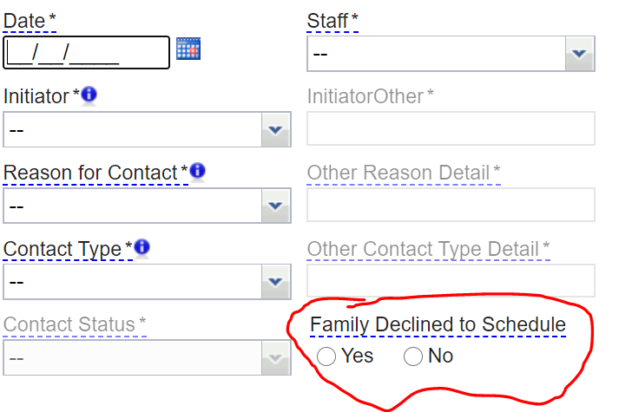
Last Cancel Rule on initial visits
We don’t want to NOT try for the 3rd visit after parents cancelled. We want to Keep our efforts up to provide quality service and Keep our integrity intact.
Marking Family Declined to Schedule applies when:
There’s a month or greater before the due date but families have declined (Ashlyn’s transition discussion mom in car wreck, then no showed, had full month before turned 27 months, but no visit scheduled. IF due to parents declining, mark this box)
When we have tried multiple times for timely initial service with no
success and parents decline when we have a month left to the due date
or
3. After multiple attempts and parents decline until after the due date

Slide 14
Remember: any change you make to the BTOTS database can be tracked and altered if need requires.
Did I do that?

Slide 15
Easy as Pie!
Contact the data entry clerkfor further questions or Sue or Marla for clarifications.
Practice on the Training Site:
https://btots.mdsc.com/
Password: trainMMYY

