Slide 1




ECHO: Unpacking the Pyramid Model – Early Intervention
Real Situations! Real Solutions!
Community of Practice
The session will start soon.
Please enter your name and organization in the chat.
In collaboration with

Slide 2
Recording
We are recording this ECHO session for educational and quality improvement purposes.
By participating in this session, you are consenting to be recorded.
If you do not wish to be recorded, please disconnect from the session.
In collaboration with

Slide 3
Participation Community of Practice
ECHO is an interactive community: presenters, stakeholders, and community members all communicate and support each other during a session.
Participants are expected to be engaged in asking questions after the didactic and to provide feedback for the case.
Real Situations! Real Solutions! discussions are the best way to solidify skills learned in the didactics and receive directly applicable advice. Consider presenting!
In collaboration with

Slide 4
Key Components of an ECHO Session
Didactic Speaker
Real Situations! Real Solutions! Presentation and Discussion
Community of Practice – information and knowledge sharing
In collaboration with

Slide 5
Please Protect Individual Privacy
When sharing information about another person or child:
Avoid using their real first, middle, or last name or any initials.
Do not identify an individual’s family members, friends, co-workers, email addresses, etc.
De-identify examples and situations.
Use the chat to contact a HUB team member if you are unsure. HUB members are those attending with an * before their name.
In collaboration with

Slide 6
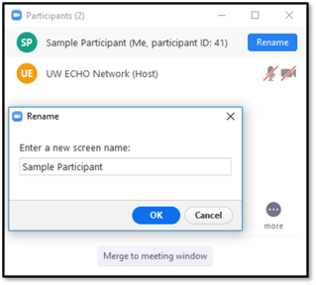
Renaming Your Zoom Profile
Please rename your profile to your first and last name, and organization, as applicable.
Click the “Participants” icon on the bottom menu of the Zoom window.
Click on your profile.
Rename your profile in the dialogue box.
EXAMPLE:
John Smith, UT, SLP, DDI VANTAGE
In collaboration with

Slide 7
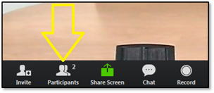
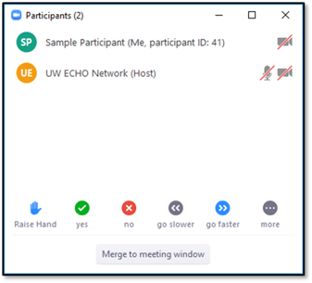
How to "Raise Your Hand"
The “Raise Hand” feature is helpful, if you have a question for the facilitator or presenter.
To use this feature, hover your mouse on the Zoom window to locate the menu at the bottom.
Select “Participants” to open the Participant window.
On the Participant window, click the “Raise Hand” option at the bottom.
In collaboration with

Slide 8
How to Get Certificate of Attendance
Fill out the feedback survey and a certificate of attendance will be emailed to you.
A link will be provided at the end of the ECHO session
A link will also be emailed to you
In collaboration with

Slide 9
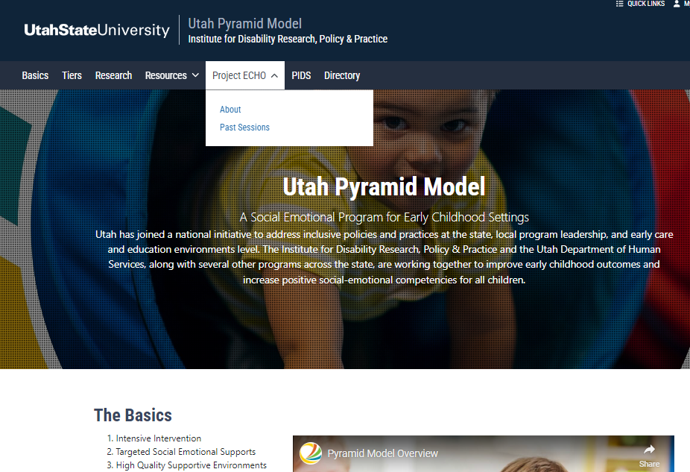
Canvas and Website
CANVAS is the platform we use to share handouts, recordings and other materials specific to Unpacking the Pyramid ECHO sessions
You must register for CANVAS to access the information
Please email Faustine Saganey, f.saganey@usu.edu to request instructions on how to register for the CANVAS page
Subject line should read, “Unpacking Pyramid ECHO CANVAS Registration Request”
Any questions with registration or after registration can be submitted to Faustine Saganey, f.saganey@usu.edu.
Canvas has a Discussion Board---One more option for connecting with other participants
In collaboration with

Slide 10
Real Situations! Real Solutions! Presentations
Is your program struggling with staff-buy in or ideas for finding time for staff to complete training?
Are you a teacher who wants ideas for Hot Spots in your classroom?
Do you need strategies for a challenging behaviors?
Consider presenting a Real Situations! Real Solutions! presentation for discussion and brainstorming to provide solutions to your program's everyday problems!!
Click on link Real Situation! Real Solutions! Presentation Template
Save template, when completed email to sue.olsen@usu.edu
In collaboration with

Slide 11
Next session:
February 24th
1 – 2:30 PM MT
Transitioning from Early Intervention to Preschool
In collaboration with

Slide 12
Session Presenter:
Chelsea Oaks
Chelsea Oaks works with USBE as a preschool specialist in the teaching and learning department. She helps oversee the school readiness grants and works on various projects that enhance the experience of children in early education such as family engagement, professional learning, etc. She was a special education teacher in a public preschool for 5 years where she focused on behavior management, data and analysis, producing legal documents (Individualized Education Programs), family engagement, technology in the classroom, coaching, and training.
In collaboration with

Slide 13
Session Topic
Stepping Stones to Special Education:
A Preschool’s Referral Blueprint
In collaboration with

Slide 14
Thank you for joining the Unpacking the Pyramid Model ECHO session!
In collaboration with

