Slide 1
Stepping Stones to Special Education
A guide for private preschool and general educators
October 25-26, 2024
Utah Preschool Conference
Chelsea Oaks, Preschool Special Education Specialist
Notes:
This presentation is designed to help preschool educators learn how to refer a child to special education in their local school district. We will cover the referral process, best practices for referrals, and reference to Utah State Law. We will end by going over resources

Slide 2
Who is in the room?

Slide 3

Learning Intentions
By the end of this presentation, you should be able to:
Tell a coworker how to refer students to special education
Share with colleagues and/or parents at least two resources related to special education

Slide 4
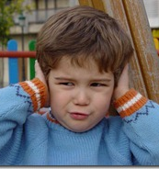
Case Study: Jamie
Change in behavior:
Overwhelmed during groups
Covers ears and looks distressed when noisy
Fixated on certain toys
Refuses to share
Refuses to transition to other activities
Not responding to name
This Photo by Unknown Author is licensed under CC BY-NC
Notes:
Imagine a preschooler named Jamie, who is usually full of energy and eager to engage in classroom activities. However, over the past few weeks, Jamie’s teachers have noticed a change in behavior. Jamie seems overwhelmed during group activities, often covering their ears and looking distressed when the classroom gets noisy. They have also started to avoid eye contact and become increasingly fixated on certain toys, refusing to share or move on to other activities.
During story time, a favorite part of the day, Jamie has begun to get up and walk around the room, no longer showing interest in the stories that once captivated them. The teachers observe that Jamie is not responding to their name as consistently as before and seems to be in their own world.
Concerned, the teachers reach out to Jamie’s parents to discuss these observations. They learn that Jamie has been exhibiting similar behaviors at home.
Can anyone relate to this story? By a show of hands, how many have had a child in their class/care that they are concerned about and don’t know what to do for?

Slide 5

Help!

Slide 6
Child Find Responsibilities
Child find refers to evaluation and referral procedures designed to locate, identify, and evaluate children who are suspected of having disabilities
Mandate under Individuals with Disabilities Education Act (IDEA)
Helps ensure a free and appropriate public education (FAPE)
Allows timely interventions that can significantly impact the children’s educational and developmental outcomes.
A Local Education Agency (LEA) is responsible for ALL children in boundaries, regardless of enrollment
Notes:
Child Find is a continuous process of evaluation and referral procedures designed to locate, identify, and evaluate children who are suspected of having disabilities and in need of Special Education and Related Services (Part B). It is a mandate under the Individuals with Disabilities Education Act (IDEA) that requires all states to have a comprehensive system to identify children who might need special education services. The process involves public awareness activities to inform the community about the availability of special education services, as well as screening and evaluation procedures to accurately identify children with disabilities. By doing so, LEAs can provide timely interventions that can significantly impact the children’s educational and developmental outcomes.

Slide 7
The Referral Process
Who Can Refer a Child?
Parents
Teachers
Administrators
Medical professionals
Steps in the Referral Process
Consent to Evaluate
Evaluation within 45 days
Determination of eligibility
Individualized Education Program (IEP), if eligible
Notes:
When a child is referred to special education, the school district will request consent from the parents or guardian of the child to evaluate. Once consent is given, the school district has 45 days to complete the evaluation. Once the evaluation is completed, an IEP team including the parents will meet to determine if the child is eligible. If so, they will then create an individualized Education Program or IEP that will address the child’s needs.

Slide 8
Eligibility
Eligibility
Assessments
Parents
Formal
Informal
Observation in classroom
Regular Education Teacher
Special Education Teacher
Related Service Providers
Representative from LEA
Requirements
13 categories for eligibility
Educational Need
Others as appropriate
Parent information
Team Members

Slide 9
Individualized Education Program (IEP)
Team Members
Parents
Regular Education Teacher
Special Education Teacher
Related Service Providers
Representative from LEA
Others as appropriate
A Few Elements of an IEP
Present Levels of Academic Achievement and Functional Performance (PLAAFP)
Goals
Services

Slide 10

Best Practices for Referral
Collaboration and Communication
Data Collection and Documentation
Notes:
Collaboration and Communication
Successful referrals for special education require collaboration and communication between parents, educators, and service providers. Ongoing communication and collaboration are key to ensuring the best outcomes for the child.
Data Collection and Documentation
Data collection and documentation are critical when referring a child to special education. Accurate and detailed data help to identify the child's needs and inform the development of appropriate interventions and services.
Share example of Mars.

Slide 11

Jamie’s Process
Private Preschool
Contact Parents
Document Behaviors
Contact LEA
LEA (Local School District)
Assess Jamie
Eligibility Meeting
Develop an IEP
Notes:
The teachers suggest that it might be beneficial to have Jamie assessed for possible developmental delays or sensory processing issues that could be impacting their learning and interaction with others.
The preschool decides to initiate the referral process for special education services. They document Jamie’s behaviors, gather input from both the teachers and parents, and with the parents’ consent, they contact the local school district to request an evaluation.
The evaluation team includes a special education teacher, a psychologist, and a speech-language pathologist who work together to assess Jamie’s needs. They observe Jamie in the classroom, conduct assessments, and interview the parents and teachers. The team concludes that Jamie would benefit from special education services to address sensory integration and communication challenges.
With a plan in place, Jamie begins to receive support from a special education teacher who collaborates with the preschool staff to implement strategies that help Jamie cope with sensory overload and engage more fully in classroom activities. Speech therapy is also introduced to support Jamie’s communication skills.
As a result of these interventions, Jamie starts to show progress. They are now able to participate in group activities with less distress, share toys more often, and show interest in story time again. The teachers and parents are relieved and hopeful as they see Jamie’s joy in learning rekindle.
This story exemplifies the importance of early identification and intervention, and the positive outcomes that can result from a well-coordinated referral and support process for children like Jamie who show signs of needing special education services.

Slide 12
What If the Child Doesn't Qualify?
Children's Center
Mental health care to infants, toddlers, preschoolers and their families and caregivers.
Utah Education Network (UEN)'s
Preschool Path
Early Learning Hub
The Pyramid Model Consortium
Introductory course
Resources

Slide 13
Additional Resources
Utah State Board of Education
Chelsea Oaks, Special Education Preschool Support Specialist
Susie Estrada, Family Engagement Support Specialist
Special Education Rules
USBE Special Education Newsletter
Preschool Pages
Special Education Preschool
High-Quality Preschool
Local School District

Slide 14
Additional Resources
Utah Parent Center
Contact care.coordination@utah.gov to access the Department of Health and Human Services’ care coordination team who can help walk you through support and services that may be available for children 0 to 8 years old.
The Sammy Center: The Sammy Center staff believes in a holistic approach and that a home-to-school model is vital for successful outcomes

Slide 15
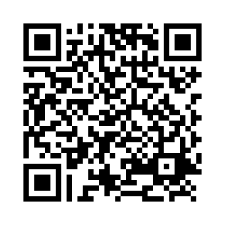
Participant Follow-Up Survey
https://usbe.az1.qualtrics.com/jfe/form/SV_blm98cAfiP8SFGC

Slide 16
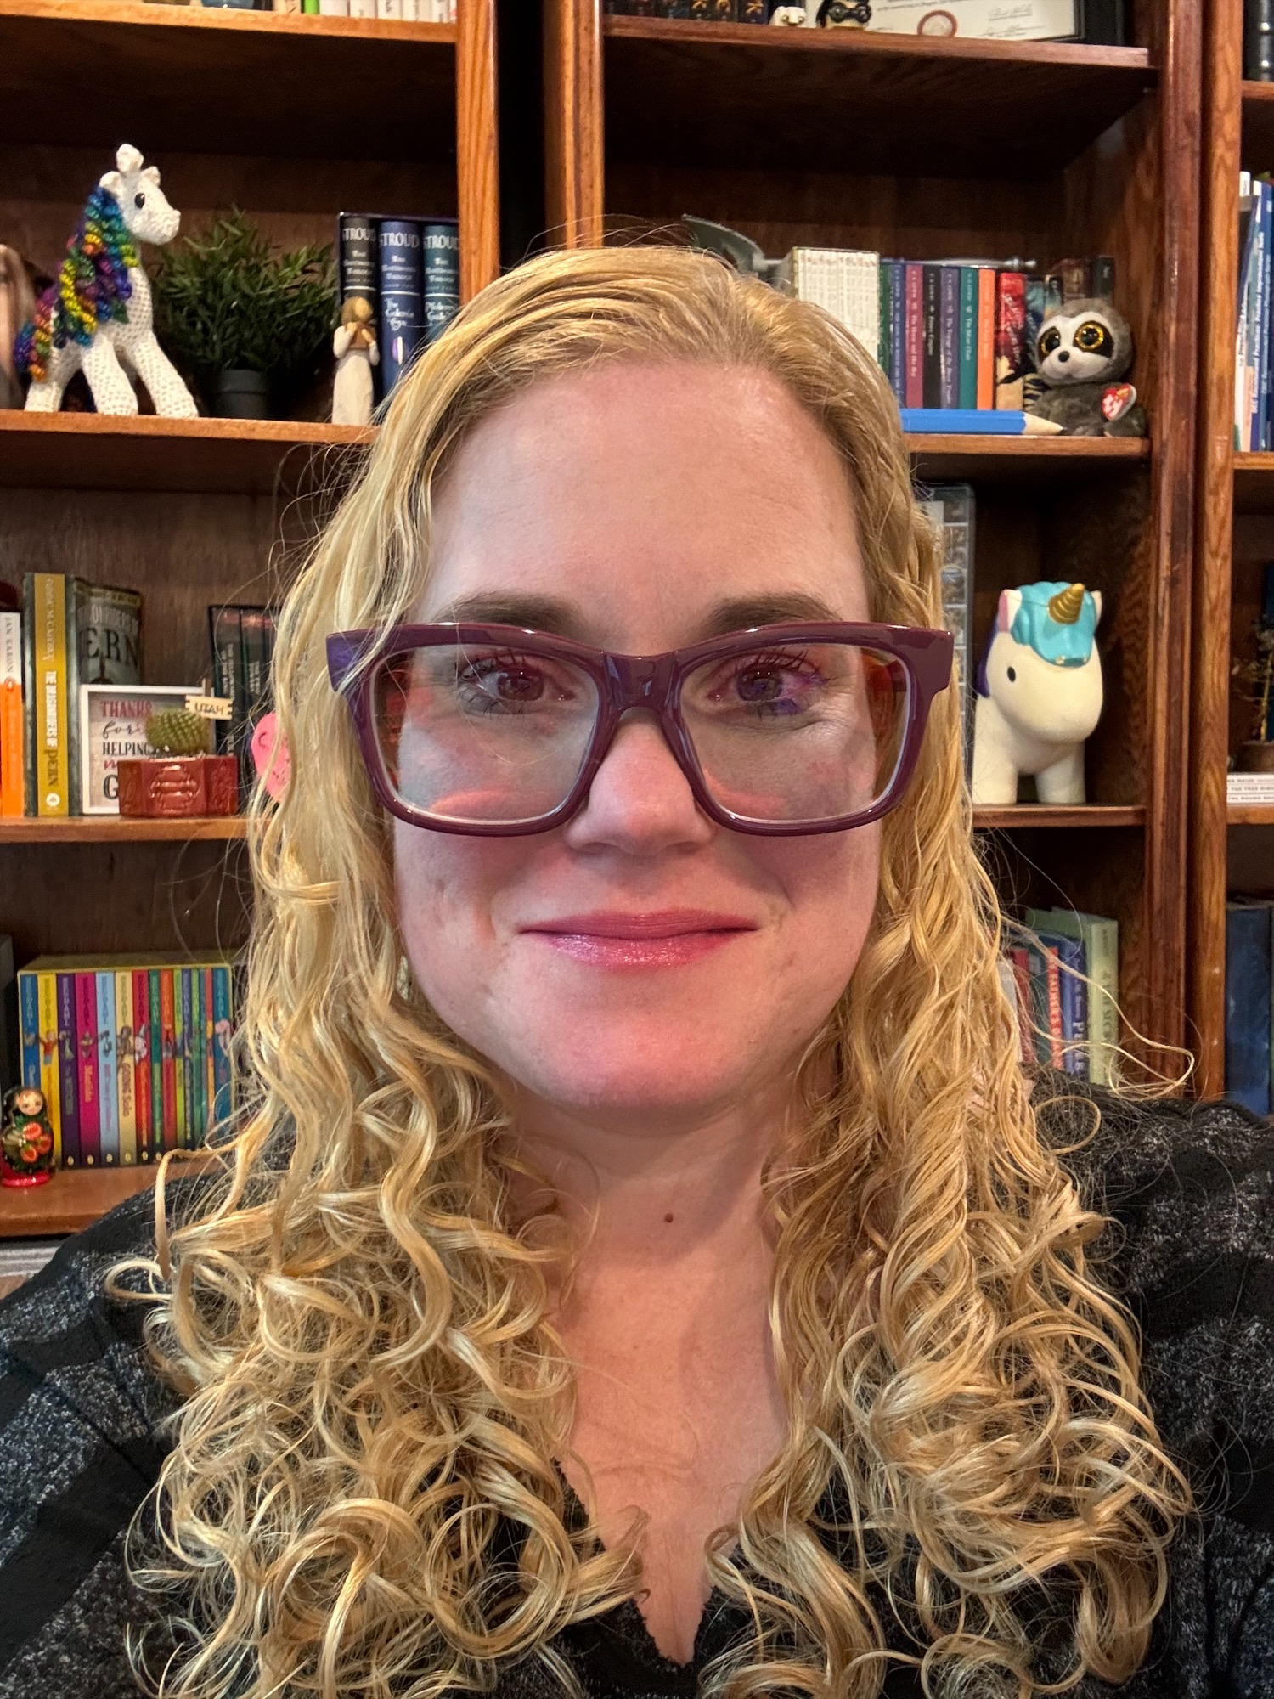
Questions?
Contact:
Chelsea Oaks, 801-538-7765
Special Education Preschool Specialist
Utah State Board of Education (USBE)

