Slide 1




ECHO: Unpacking the Pyramid Model – Early Intervention
Real Situations! Real Solutions!
Community of Practice
The session will start soon.
Please enter your name and organization in the chat.
In collaboration with

Slide 2
Recording
We are recording this ECHO session for educational and quality improvement purposes.
By participating in this session, you are consenting to be recorded.
If you do not wish to be recorded, please disconnect from the session.
In collaboration with

Slide 3
Participation
Community of Practice
ECHO is an interactive community: presenters, stakeholders, and community members all communicate and support each other during a session.
Participants are expected to be engaged in asking questions after the didactic and to provide feedback for the case.
Real Situations! Real Solutions! discussions are the best way to solidify skills learned in the didactics and receive directly applicable advice. Consider presenting!
In collaboration with

Slide 4
Key Components of an ECHO Session
Didactic Speaker
Real Situations! Real Solutions! Presentation and Discussion
Community of Practice – information and knowledge sharing
In collaboration with

Slide 5
Please Protect Individual Privacy
When sharing information about another person or child:
Avoid using their real first, middle, or last name or any initials.
Do not identify an individual’s family members, friends, co-workers, email addresses, etc.
De-identify examples and situations.
Use the chat to contact a HUB team member if you are unsure. HUB members are those attending with an * before their name.
In collaboration with

Slide 6
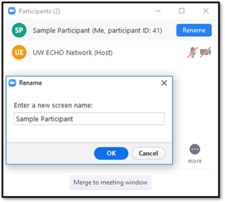
Renaming Your
Zoom Profile
Please rename your profile to your first and last name, and organization, as applicable.
Click the “Participants” icon on the bottom menu of the Zoom window.
Click on your profile.
Rename your profile in the dialogue box.
EXAMPLE:
John Smith, UT, SLP, DDI VANTAGE
In collaboration with

Slide 7
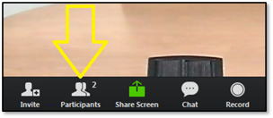
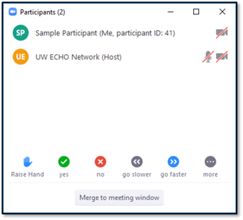
How to "Raise Your Hand"
The “Raise Hand” feature is helpful, if you have a question for the facilitator or presenter.
To use this feature, hover your mouse on the Zoom window to locate the menu at the bottom.
Select “Participants” to open the Participant window.
On the Participant window, click the “Raise Hand” option at the bottom.
In collaboration with

Slide 8
How to Get
Certificate of Attendance
Fill out the feedback survey and a certificate of attendance will be emailed to you.
  A link will be provided at the end of the ECHO session
  A link will also be emailed to you
In collaboration with

Slide 9
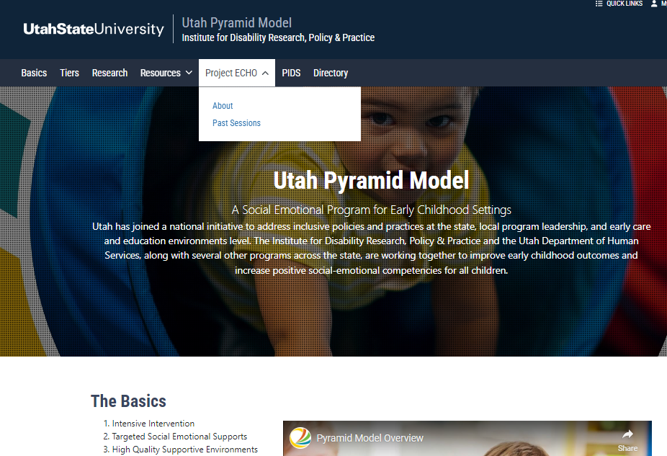
Canvas and Website
CANVAS is the platform we use to share handouts, recordings and other materials specific to Unpacking the Pyramid ECHO sessions
You must register for CANVAS to access the information
Please email Faustine Saganey, f.saganey@usu.edu to request instructions on how to register for the CANVAS page
Subject line should read, “Unpacking Pyramid ECHO CANVAS Registration Request”
Any questions with registration or after registration can be submitted to Faustine Saganey, f.saganey@usu.edu.
Canvas has a Discussion Board---One more option for connecting with other participants
In collaboration with

Slide 10
Real Situations!
Real Solutions! Presentations
Is your program struggling with staff-buy in or ideas for finding time for staff to complete training?
Are you a teacher who wants ideas for Hot Spots in your classroom?
Do you need strategies for a challenging behaviors?
Consider presenting a Real Situations! Real Solutions! presentation for discussion and brainstorming to provide solutions to your program's everyday problems!!
Click on link Real Situation! Real Solutions! Presentation Template
Save template, when completed email to sue.olsen@usu.edu
In collaboration with

Slide 11
Next session:
September 23
1 – 2:30 PM MT
Positive Caregiving Practices and Preventing Challenging Behaviors in EI
In collaboration with

Slide 12
New Series Starting November
Poll:
What time are you most available?
In collaboration with

Slide 13
Session Presenter:
Erin Barton
Erin E. Barton, PhD, BCBA-D, is an international educational consultant and Faculty for the Pyramid Model Consortium. She has worked in the field of education for over thirty years in many different capacities including as a special education teacher, family coach, and university professor. She developed the training materials, coaching tools, and overall approach for using the Pyramid Model in early intervention systems. She provides TA and coaching on the program-wide use of the Pyramid Model in early intervention to states, agencies, and districts. She is a Board Certified Behavior Analyst and directs research projects related to evidence-based practices for young children, policies and practices that support high quality inclusion, and effective professional development systems. Dr. Barton is an active scholar with over 120 publications in major journals, multiple chapters, and several textbooks related to evidence-based practices. Dr. Barton serves on several editorial boards and is the Editor-in-Chief of Topics in Early Childhood Special Education. She has received many honors including as the 2021 Peabody Faculty Excellence Award: Service to Students and 2020 Chancellor’s Faculty Fellow at Vanderbilt University. She also was honored with the 2019 Merle B. Karnes Award for Service to the Division for Early Childhood and the 2017 Distinguished Early Career Research Award from the Division for Research of the Council for Exceptional Children.
In collaboration with

Slide 14
Session Topic
Effective, Family-Centered Coaching
In collaboration with

Slide 15
Thank you for joining the Unpacking the Pyramid Model ECHO session!
In collaboration with

