Slide 1
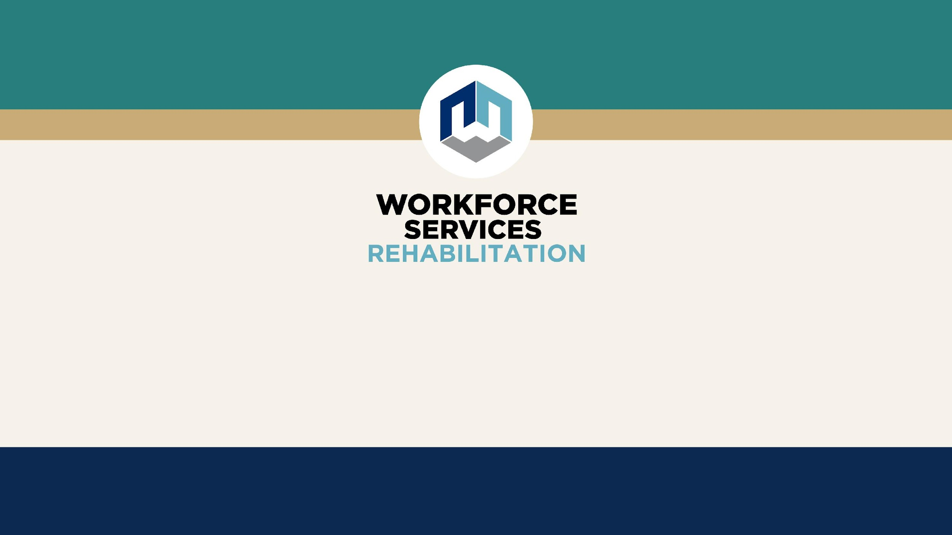
Introduction to
Vocational Rehabilitation (VR)

Slide 2

What is Vocational Rehabilitation (VR)?
The Vocational Rehabilitation (VR) program assists individuals with disabilities to obtain employment and increase their independence.

Slide 3

What Counts As a Disability?
Any physical or mental condition that limits a person's ability to complete major life activities, such as: breathing, walking, talking, hearing, seeing, sleeping, caring for one's self, performing manual tasks, and working.

Slide 4
Examples of Disabilities
This includes, but is not limited to:
Alcohol or Substance Dependance
Mental Health Conditions
Autism
Cerebral Palsy
Intellectual/ Developmental Conditions
Diabetes
ADHD
Learning Disorders
Spinal Cord Injury
Traumatic Brain Injury
Respiratory Disorders
Multiple sclerosis
Blindness / Vision Loss
Deaf / Hard of Hearing
Amputation
Other Physical Conditions/Disorders

Slide 5
VR Eligibility Criteria
VR Counselors review medical records and initial interview
information to make a determination of eligibility based on the following four criteria:
Does a significant physical or mental impairment exist?
Does this impairment result in a substantial barrier to employment?
Does the individual require VR services?
Will the individual benefit in terms of an employment outcome?

Slide 6
VR Eligibility Criteria (cont,.)
Presumptive Eligibility:
  If an individual is receiving SSDI/SSI for their own disability, they are “Presumed Eligible” for VR Service.

Slide 7
Plan Development
After the client is found eligible, they work with their VR Counselor to develop an Individual Plan for Employment (IPE).
  The IPE outlines the steps and services that the client will need to become successfully employed and addresses the following:
    Clients strengths, interests and past work experience.
    Selecting a Vocational Goal (job goal)
    Remediating clients disability
    Exploring comparable benefits and services
    Identifying the services needed to help the client become successfully employed.

Slide 8
What Types of Services Are Available?
Services are based on individual need and an employment plan developed with a VR Counselors. This could include:
Counseling and Guidance
Diagnostic Evaluations
Medical Services and Treatment
Assistive Technology
Education & Training
Job Placement
Support Services, such as transportation assistance, clothing/tools/supplies for work or help with expungement fees
  Note: VR is not able to pay for fines or restitution.

Slide 9
Employment
Once a client becomes employed in the vocational goal selected on their IPE, the counselor will work with them to begin closing their case.
  Case closure happens after at least 90 days of successful employment
  During employment, services to support client continue to ensure the client is stable in their chosen job.
  Counselor will communicate with the client during the employment phase and notify them along the way as they work toward case closure.

Slide 10
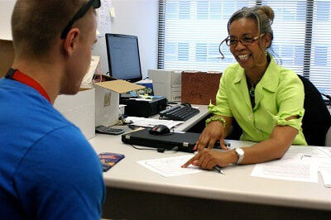
How to Apply
Contact a local VR office.
  Find the nearest Vocational Rehabilitation (VR) office by using the Office Locator tool at jobs.utah.gov/usor/vr
Schedule an orientation and/or obtain an application.

Slide 11
How to Apply (cont.,)
3. A client would meet with a VR counselor to assist them in obtaining medical documentation of their disability.
  If there are no appropriate records, VR can pay for a diagnostic assessment. Eligibility decisions can take up to 60 days, but on average take 30 days or less.
4. Next steps if Eligible - A client would work with a VR Counselor to develop an Individualized Plan for Employment and start working toward goals

Slide 12
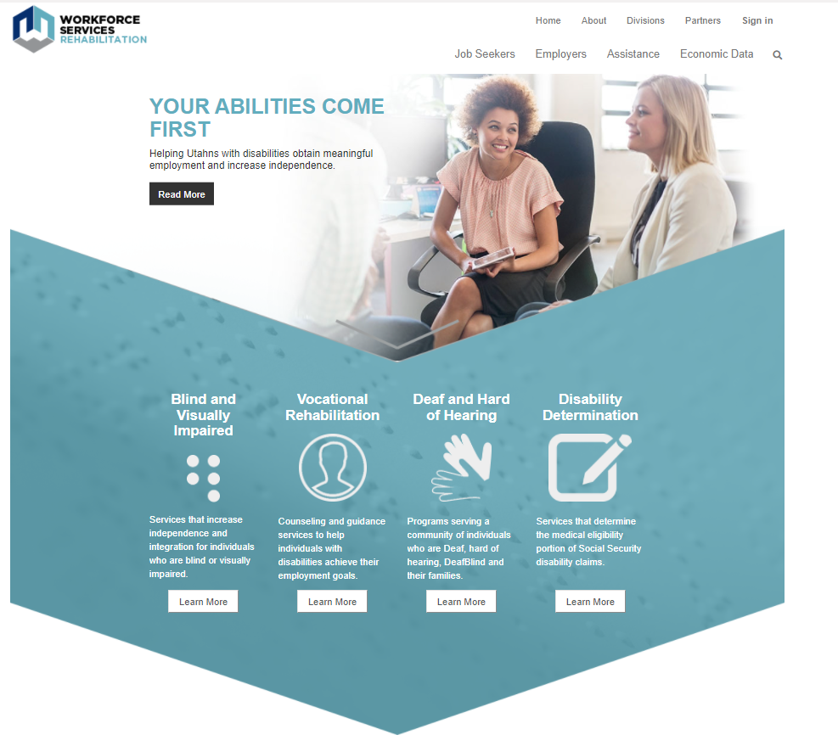
For More Information
Visit: jobs.utah.gov/usor

