Slide 1




Lived Experiences of Domestic and Sexual Violence:
Moving Forward Through Awareness and Collaboration
October 8, 2026

Slide 2

Today’s Discussion
Identify the impact of sexual violence, domestic violence, and complex trauma through lived experiences.
Examine how the voices of survivors can guide practice, policy, and cross-sector collaboration.
Share efforts to increase awareness, resources, and prevention through the “From Silence to Safety” initiative.
Describe community-based collaboration efforts that reduce risk and promote safety.

Slide 3

Presenters
Lynne Tomasa, PhD, MSW, FAAIDD
Research to Practice
Celina Urquidez, MPH
Public Awareness and Training
Gina Griffiths, MSW
Statewide Network and Collaboration

Slide 4
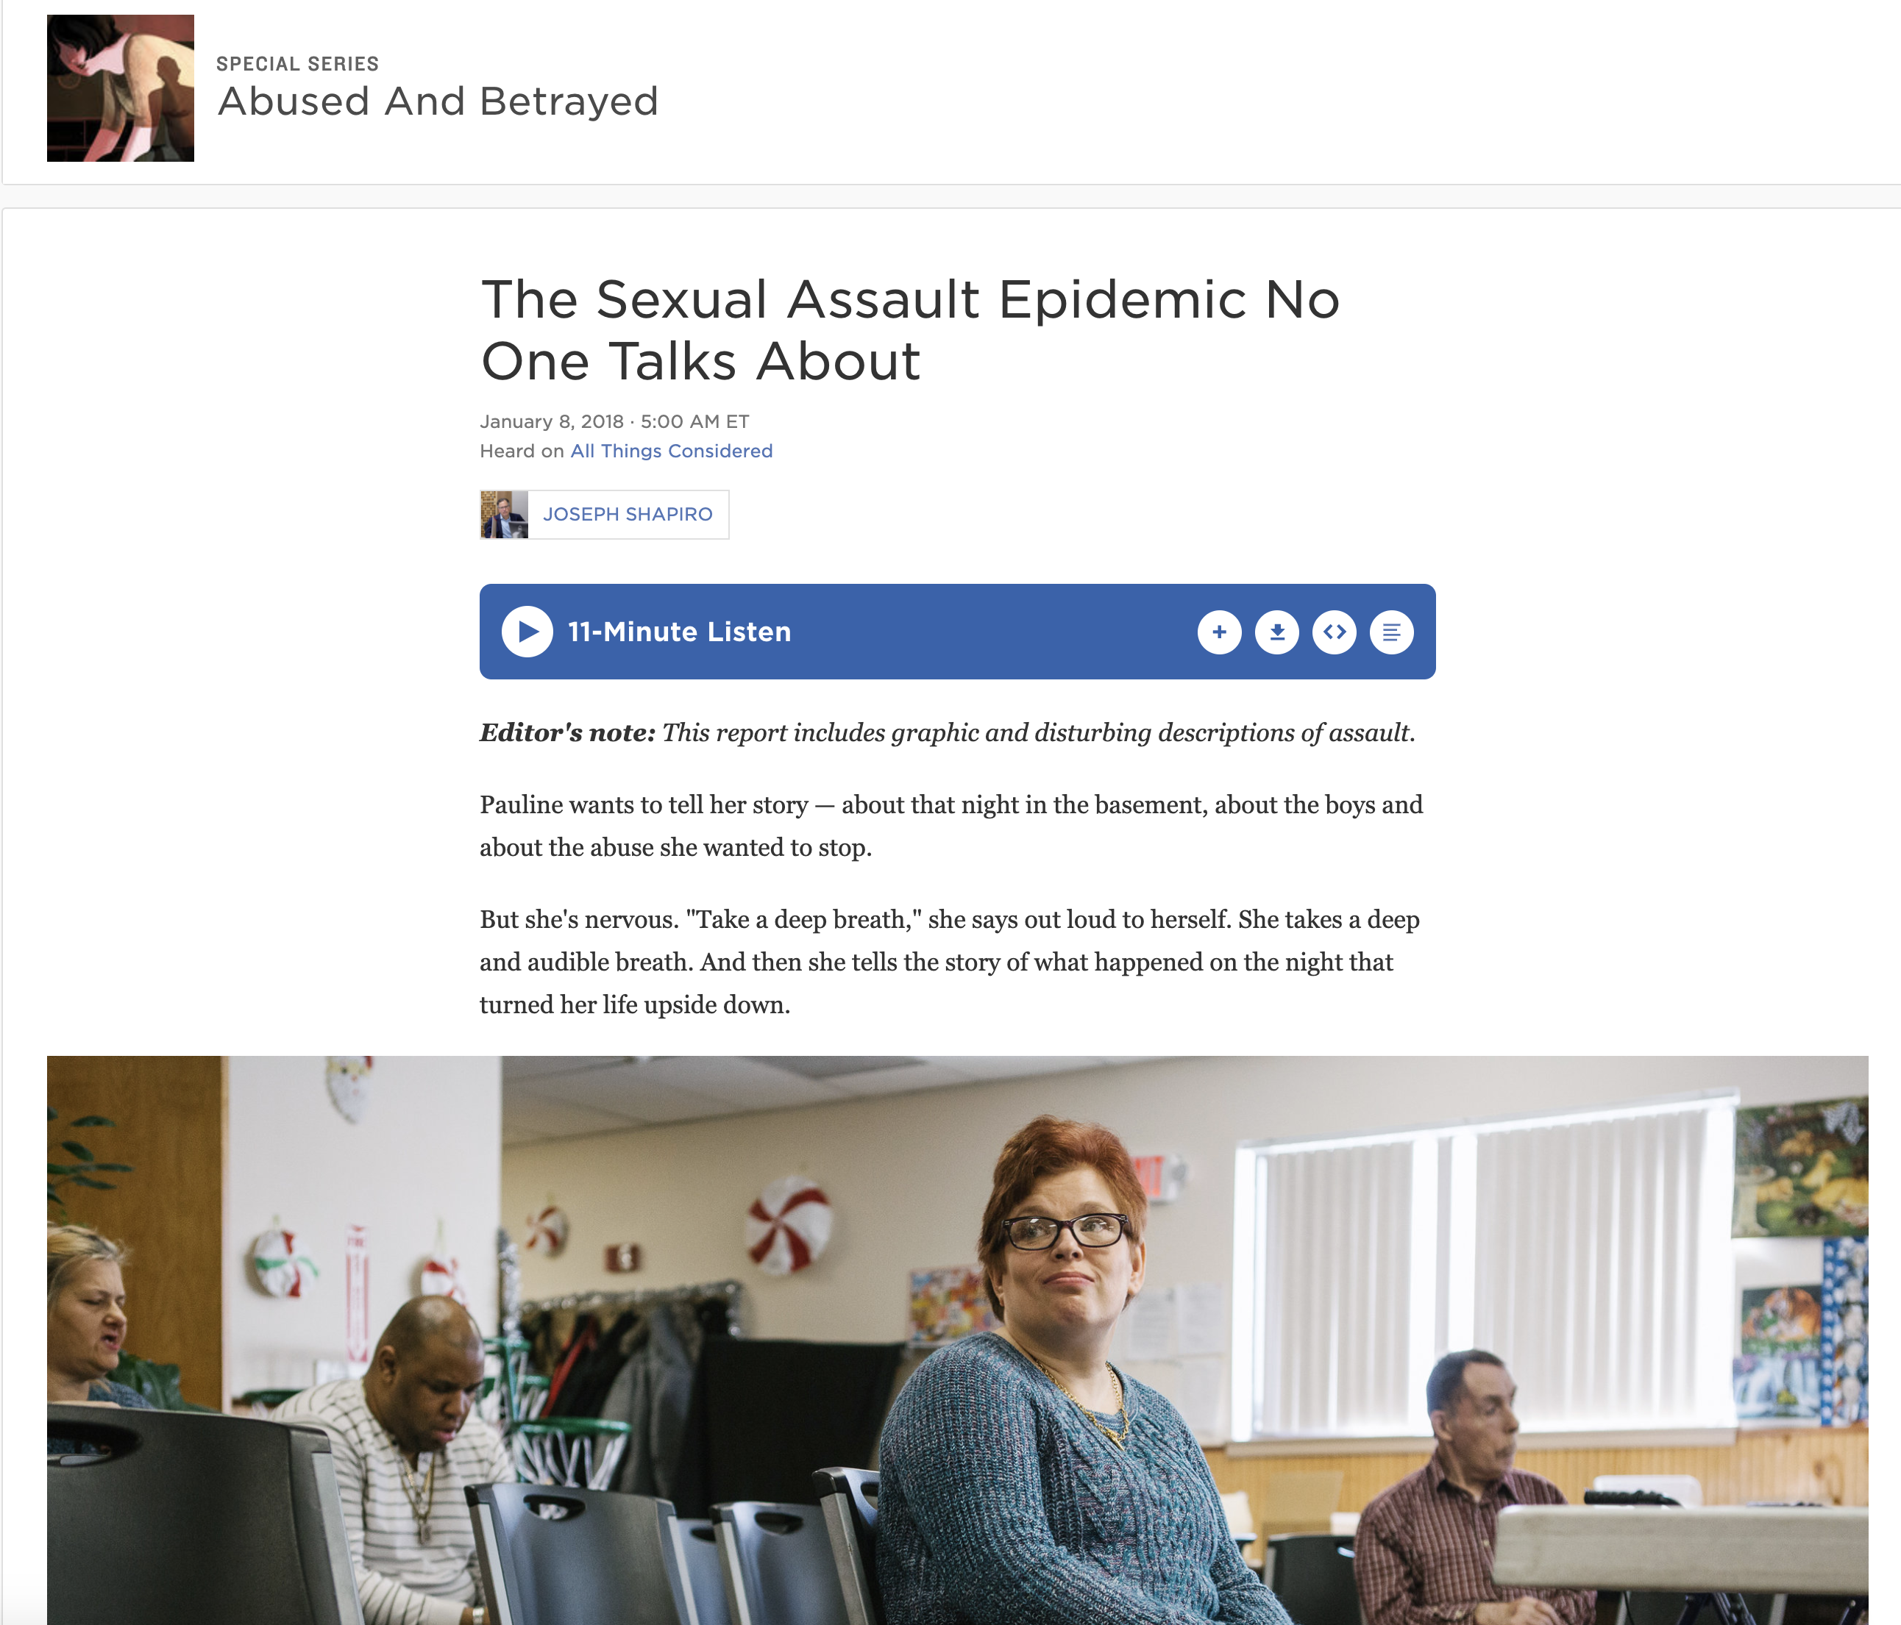
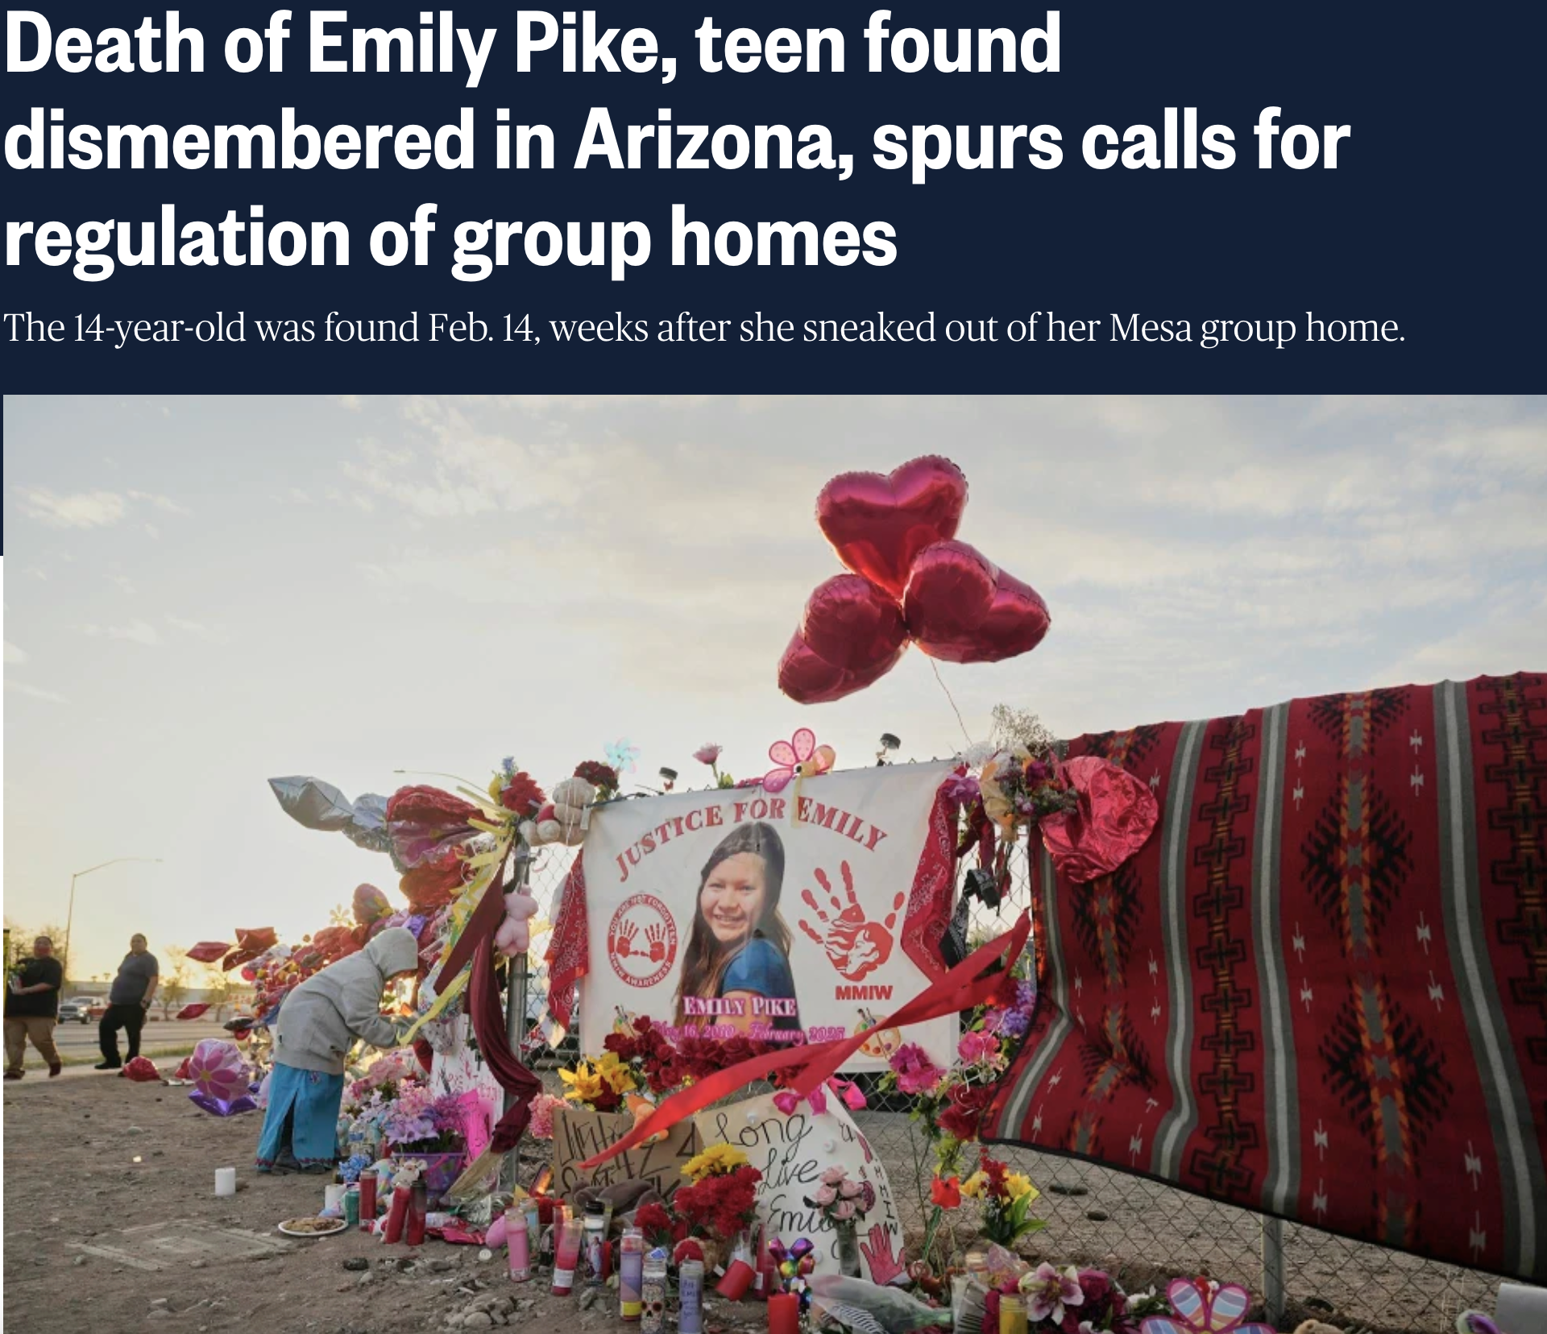
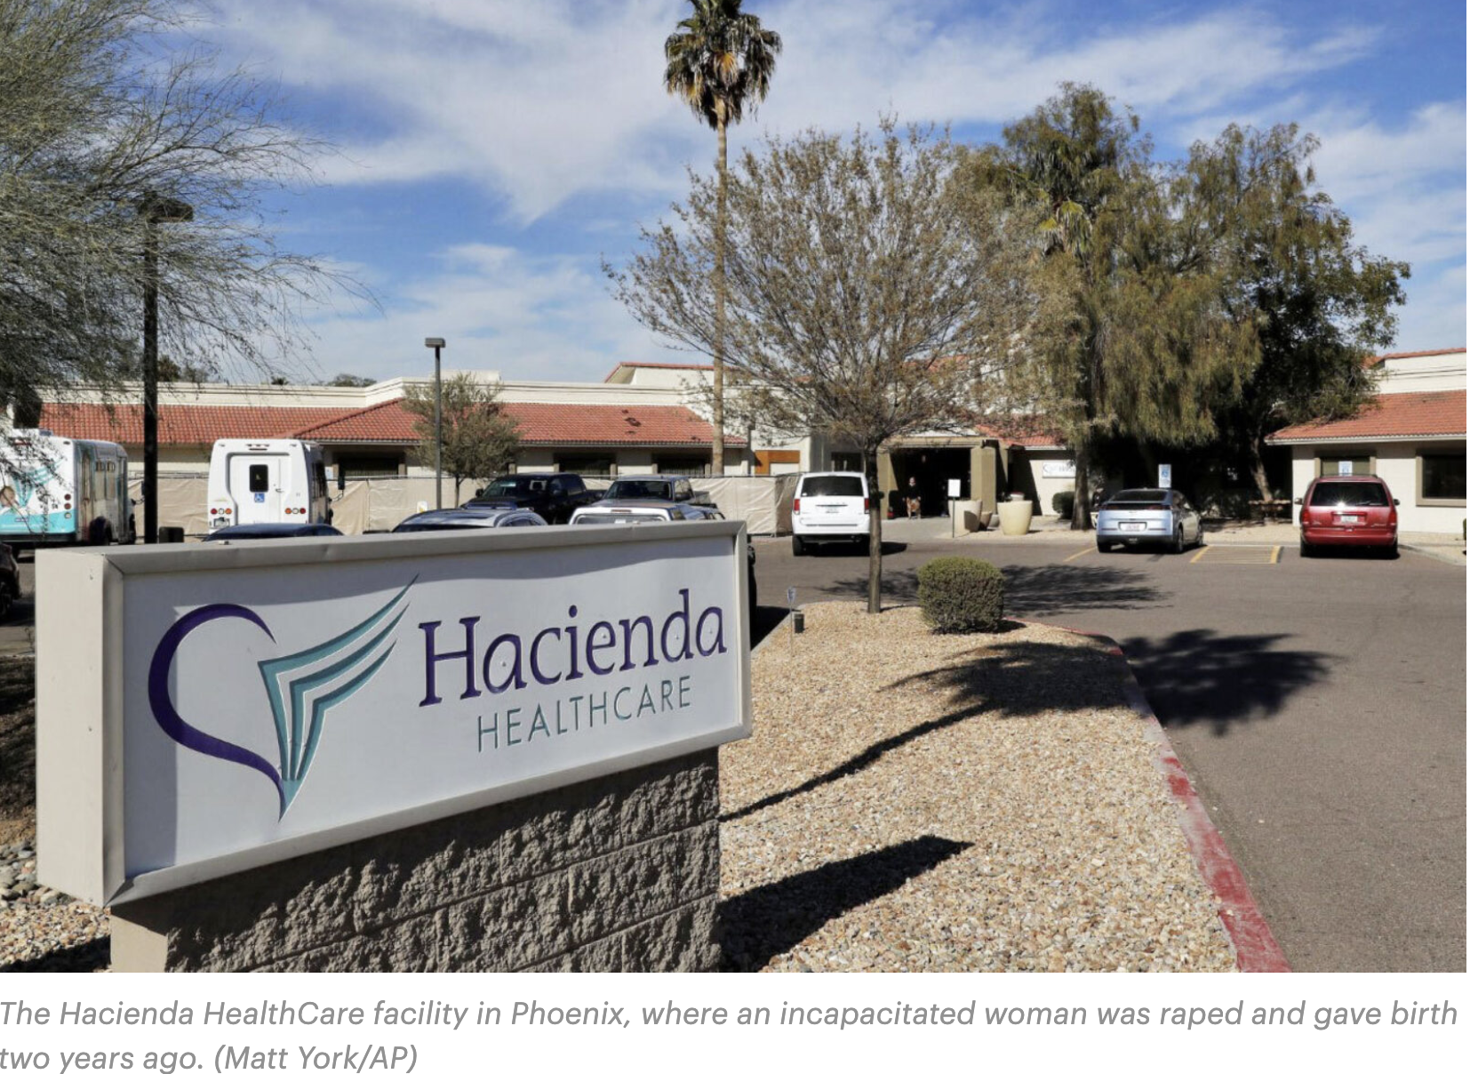
National and State Investigations
2025
2018
2018
Notes:
Background

Slide 5
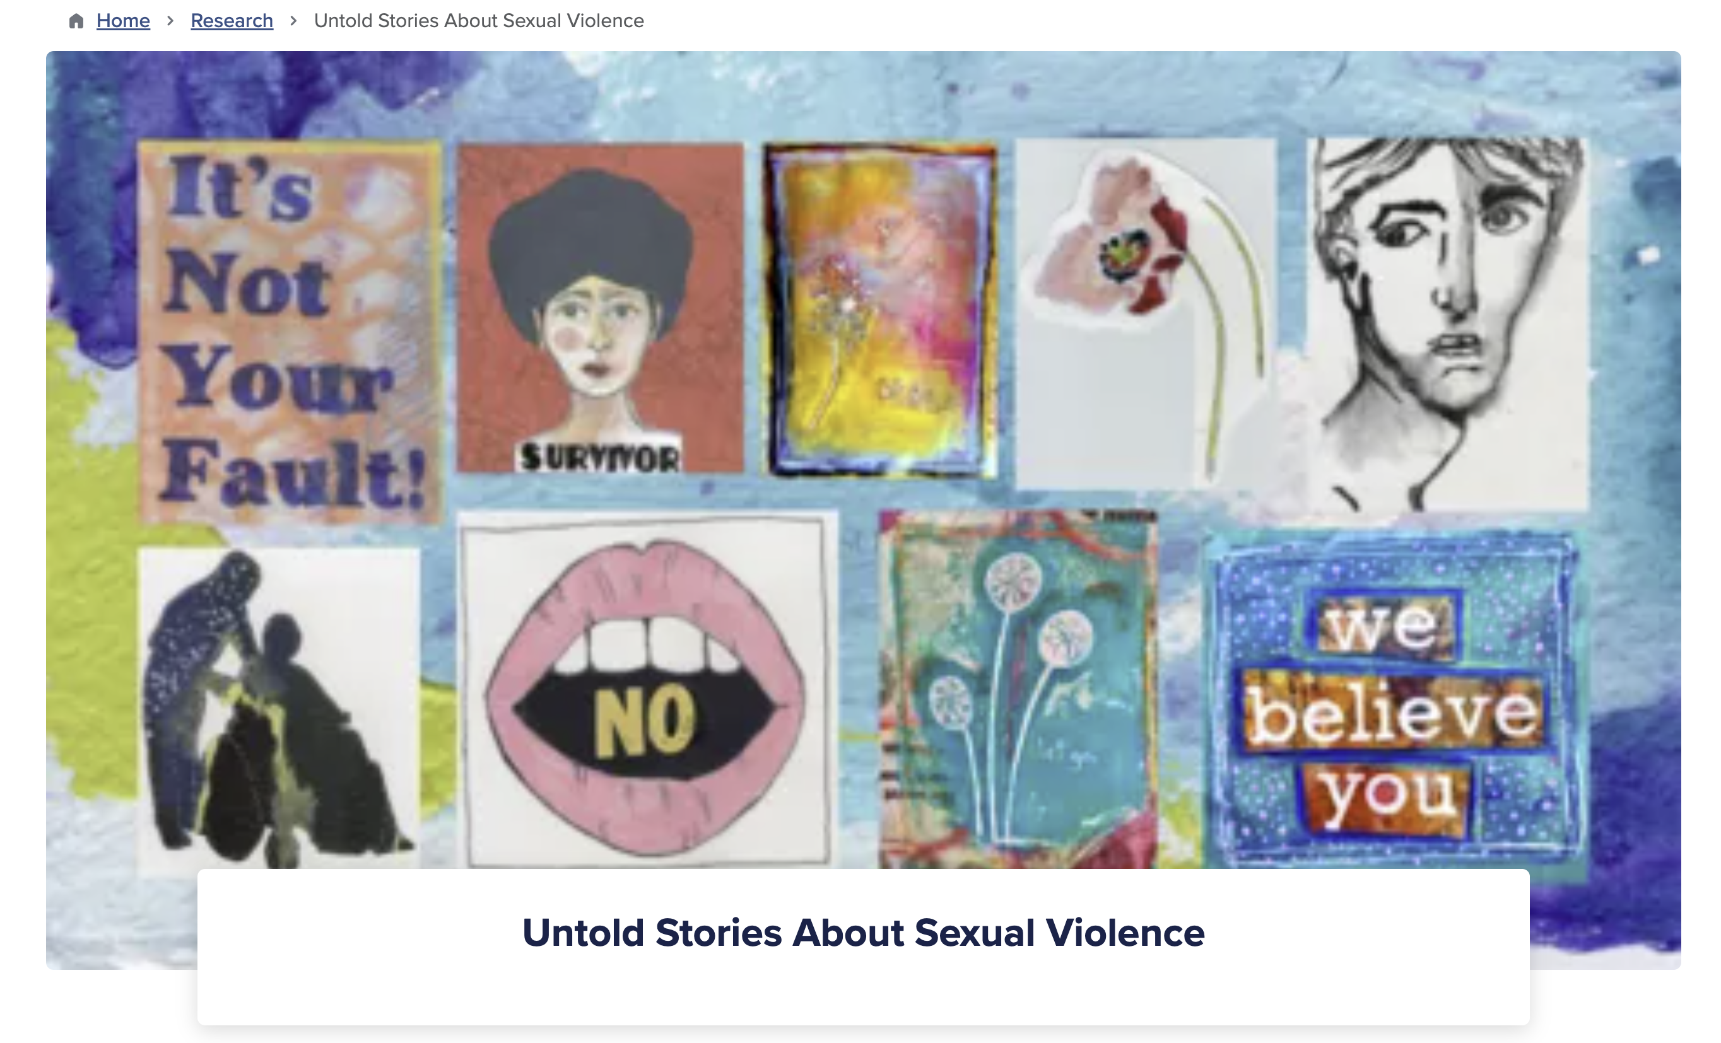
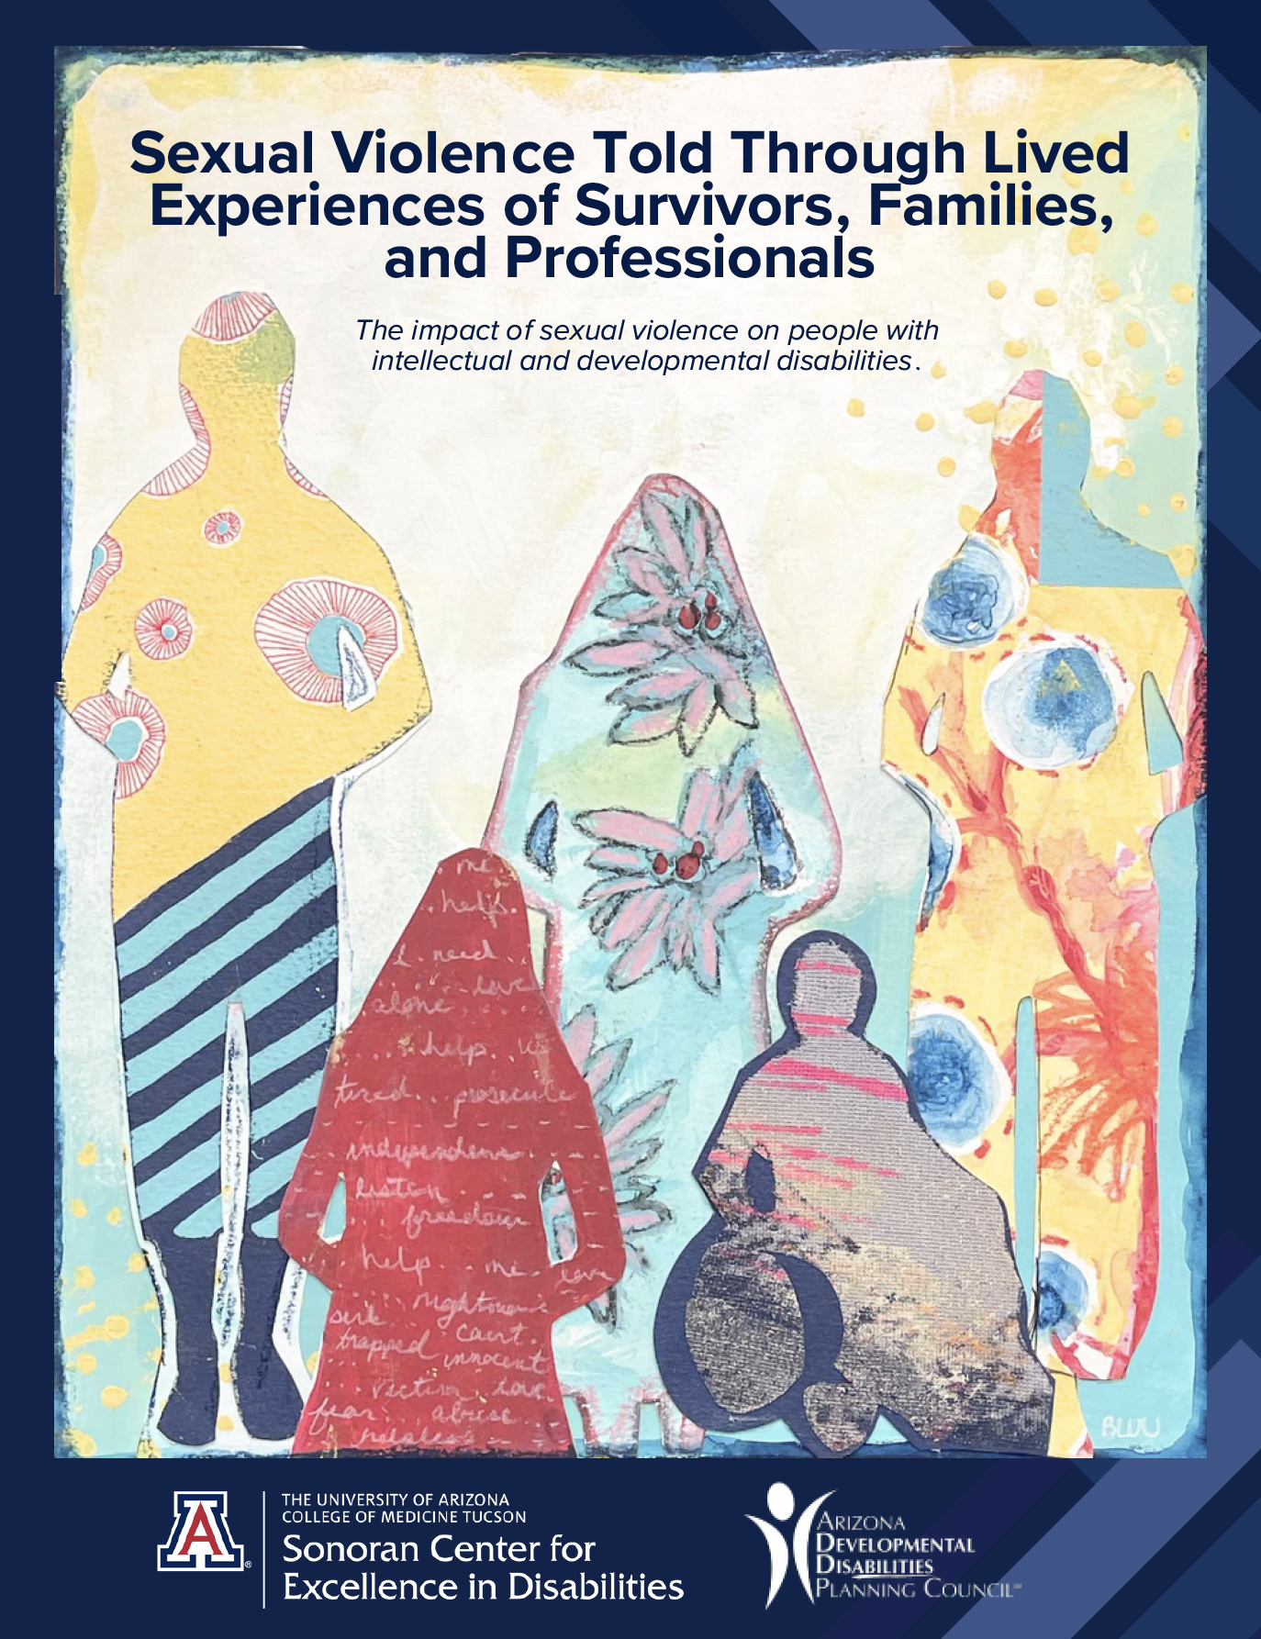
UnTold Stories Project:
Lived Experiences of Survivors, Families, & Professionals
https://sonorancenter.arizona.edu/research/untold-stories-about-sexual-violence
Notes:
Provide overview of the project

Slide 6
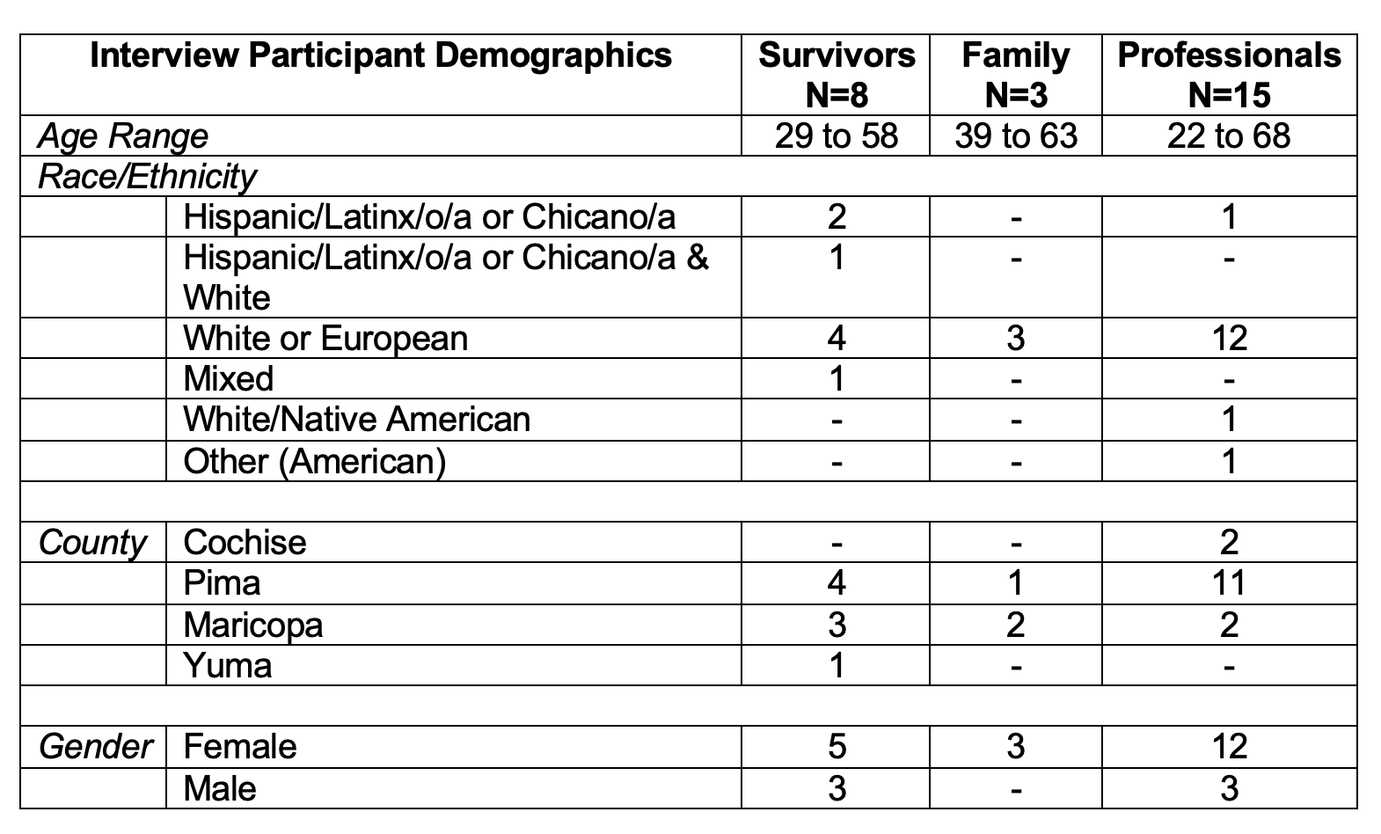
Participant Demographics: Arizona
Notes:
Provide overview of the project

Slide 7
Survivor: Males
Started at 5 years old when babysitter asked him to “stimulate her” in the shower. It happened multiple times over two-years.
Traveled with a group and had non-consensual oral sex. Later experience domestic violence that included physical abuse where it “felt like she could dominate me because she was able to physically lift me.”
Abused by multiple individuals: someone at a hotel who offered to help, personal care assistants, and peer at work.

Slide 8
Survivor: Females
Became friends with a couple who lived in the same apartment complex. During a manic state, the male “tried to force penetration.”
Met someone at work and lived together. Became isolated from family and friends. Abuse included threats with a knife, withholding food, hitting, rape, mocking, and stalking.
Bullied during elementary, middle and high school. Behaviors became more sexual and included threats, and pressure to do things. Later abused by a boyfriend who threatened to harm himself if she left.

Slide 9
Survivor: Females
Mother’s boyfriend started grooming her at age 11. Perpetrator was charismatic and made her believe that he loved her like a dad and boyfriend. At 15 years old, “I was on medication, and we had intercourse…I was so out of it.” Reported abuse when 18 years old.
Perpetrator sat next to her, and he touched her leg without her consent. Later, at summer camp (age 15), “camp counselor that was helping me to take a shower, started touching my private parts and asked me if it tickled.”

Slide 10
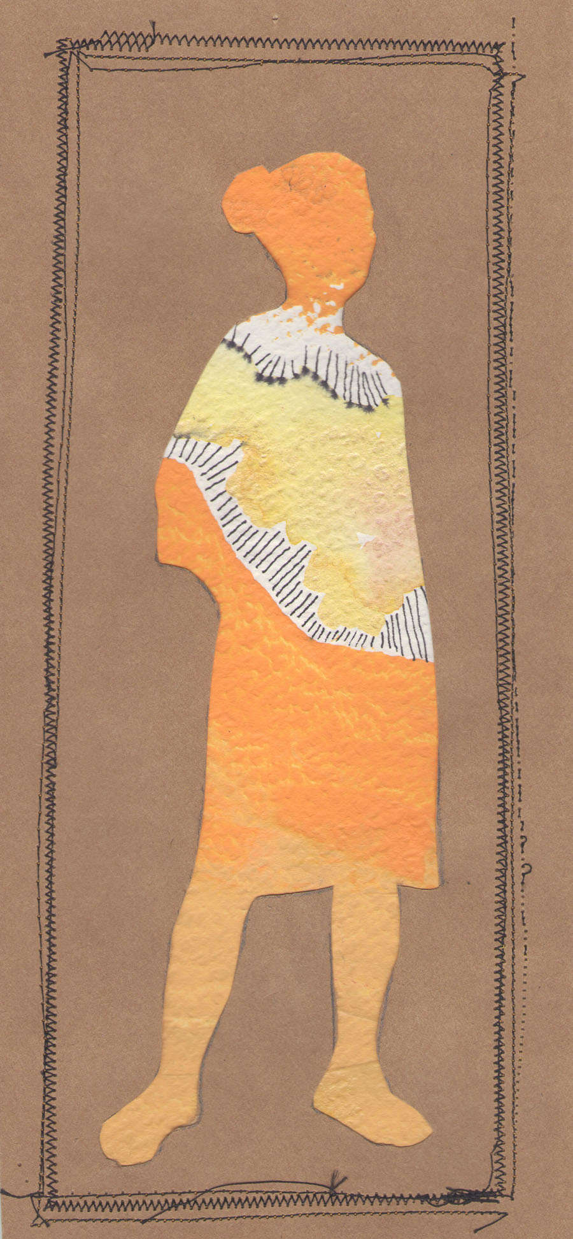
Perpetrator Behaviors
“Apparently, this guy been taking her on walks – isolating her. Pulling her from the group. And how this wasn’t a red flag, I don’t know…, he would take her for walks or take her for drives.
He certainly manipulated her too and told her that he really liked her like a girlfriend.
One of the heartbreaking things she said to me when she first divulged this, I wanted him to like me. Nobody normal ever liked me before.”

Slide 11

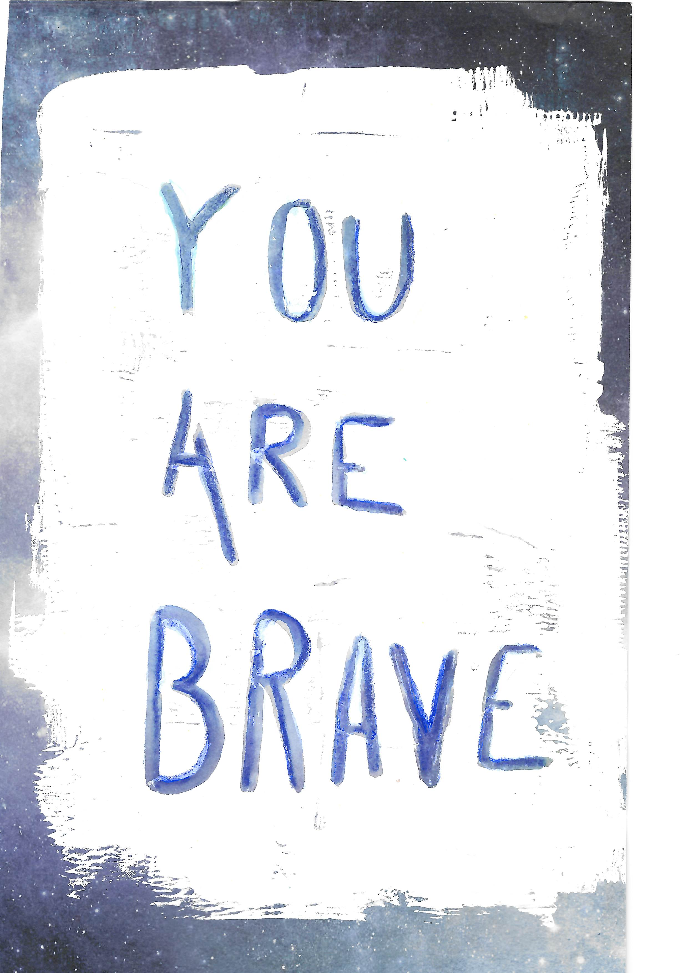
Reporting the Abuse
A police report was file but “Nothing ever came of it.”
“The minute that I said that I was being raped by my stepdad, everything stopped. All of a sudden, my teachers figured stuff out that they should have been figuring out ages ago.”
“Just recently, I came out to my family. They didn’t know the full extent of it. Once they found out that I was being beaten and raped, all this other stuff. That’s when they decided, I need help because I get panic attacks and horrible depression.”

Slide 12
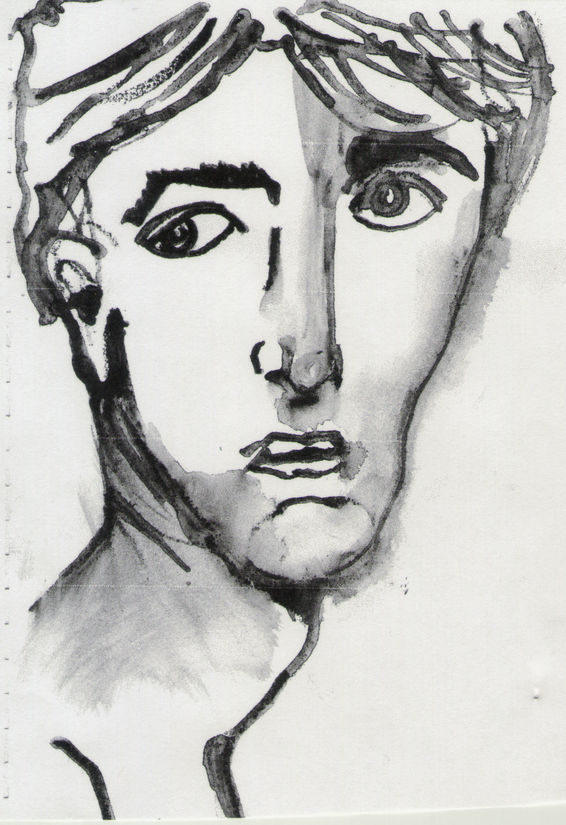
Devastating Impact
Symptoms of trauma lasted for months, years, or throughout their lives
Recurrent memories, upsetting dreams, emotional blunting
Not able to do activities of daily living
Impact on quality of life and mental health
  Self-blame, depression, fear, shame
  Not able to maintain/build new relationships
  “I had times where I was, like, Do I matter?”

Slide 13
Family Experiences
Daughter met perpetrator on social media site. He told her that she was not brave enough to allow him to take pictures of her unclothed body. “It’s put a wedge between her (daughter) and my relationship. We used to be extremely close.”
Child was bullied in high school. Peers laughed at him and told him “some really horrible things” in front of his classroom. He was also videotaped while in the restroom.
A male college student lived on campus and was controlled by a female student. She convinced him that, “He shouldn’t lean on us (parents) and that he could lean on her. Then she had sex with him, because she knew that could manipulate him.”

Slide 14
Family Experiences
A male college student lived on campus and was controlled by a female student who “targeted him and purposely messed with him and destroyed him.”
  “She had him sleeping from 4 a.m. to 5 p.m. He was only eating one meal a day. All of this was done so that she could break him down and manipulate him.”
  She convinced him that “he really shouldn’t lean on us (parents) and that he could lean on her. That was kind of the first step. Then she had sex with him, because she knew that could manipulate him.”

Slide 15

Professionals Speak
Knew about the prevalence and underreporting.
Emphasized that survivors will explain their experiences differently (literally) and often indirectly.
Concerned about how perpetrators went from one agency to another because, “until they're prosecuted and when they're doing the background checks, they can get hired elsewhere.
“Staff aren't around long enough to get to know the members, who—many of our members are telling us they're being victimized through their paraverbal or their body language. And suddenly the demeanor has dramatically changed”

Slide 16
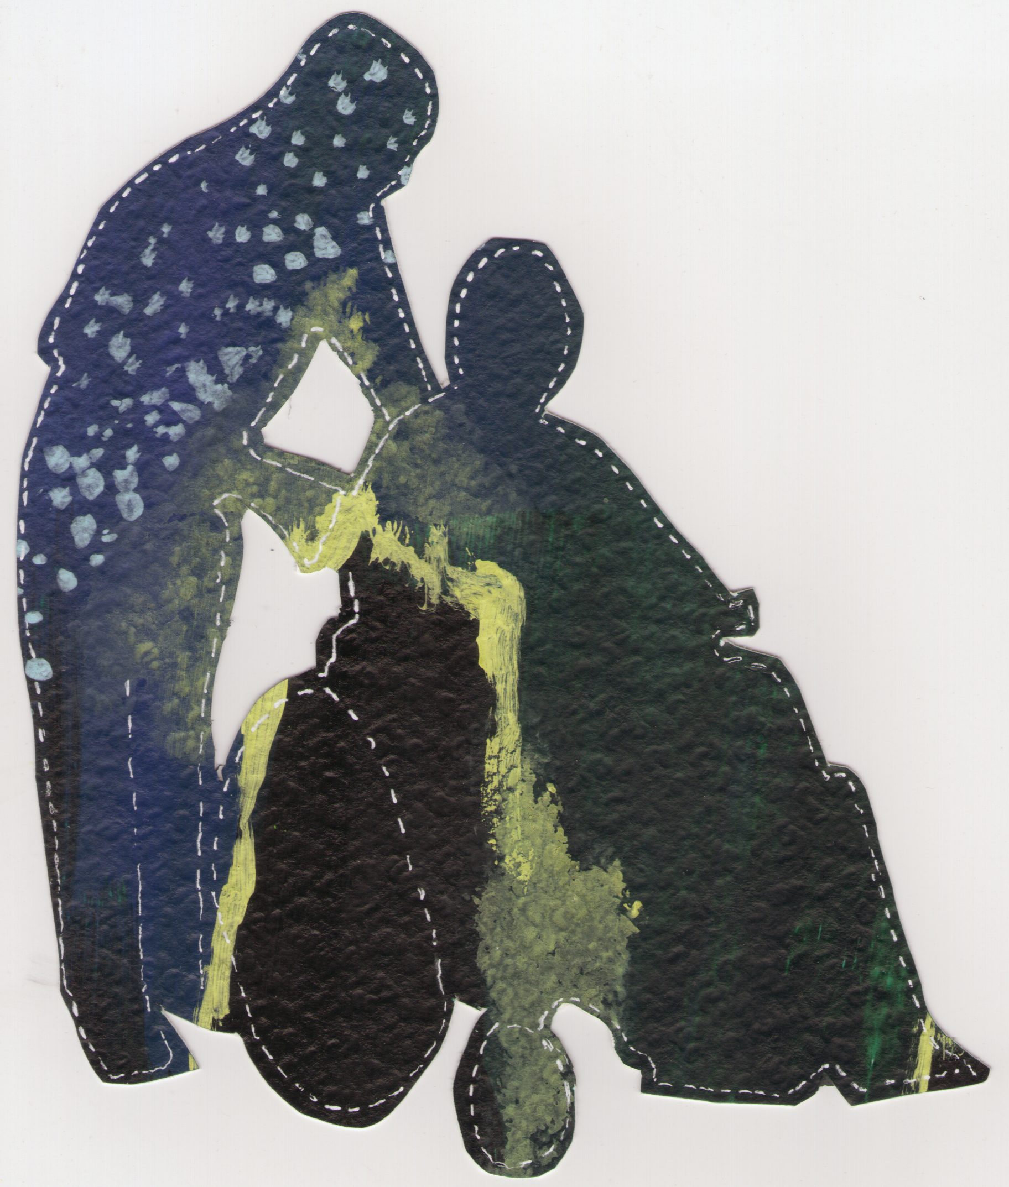
What We Learned
Victimization happens at a young age
Perpetrators have a plan and find opportunities to do harm
Domestic violence and control over a person often escalate
Someone should have known or observed what was happening

Slide 17
What We Learned
Individuals often experience multiple incidents
The trauma impacts the person’s quality of life
It takes a long time before a person feels ready or safe to report what happened
Mental health counseling is effective

Slide 18


Slide 19
Project Objectives
Develop a strategic plan to coordinate a sexual violence awareness campaign
Review and adapt existing resources to be housed on the Sonoran Center website
Develop partnerships to address policies that impact survivors and families
Support statewide efforts that engage policymakers and elected officials in policy change
Collaborate with academic programs that train future professionals/workforce to integrate sexual violence curriculum

Slide 20
From Silence to Safety Information Sheets
Untold Stories Research Summary
A Family and Caregiver’s Guide to Addressing Sexual Abuse
Sexual Harassment and Disability in the Workplace
Safety Awareness: Keeping Each Other Safe
Bullying: Tips on What to Do

Slide 21
Information Sheets
In Progress
Online Safety
Healthy Friendships
Adverse Childhood Experiences and Trauma Informed Approaches
Safety, Support, and Your Rights: Information for the Deaf and Hard of Hearing Community
Resource List

Slide 22
Important Considerations
Plain and accessible language
Audience
Length
Partnerships in development
Integration of existing resources
Community needs
Notes:
Where we have been and where we hope to go

Slide 23
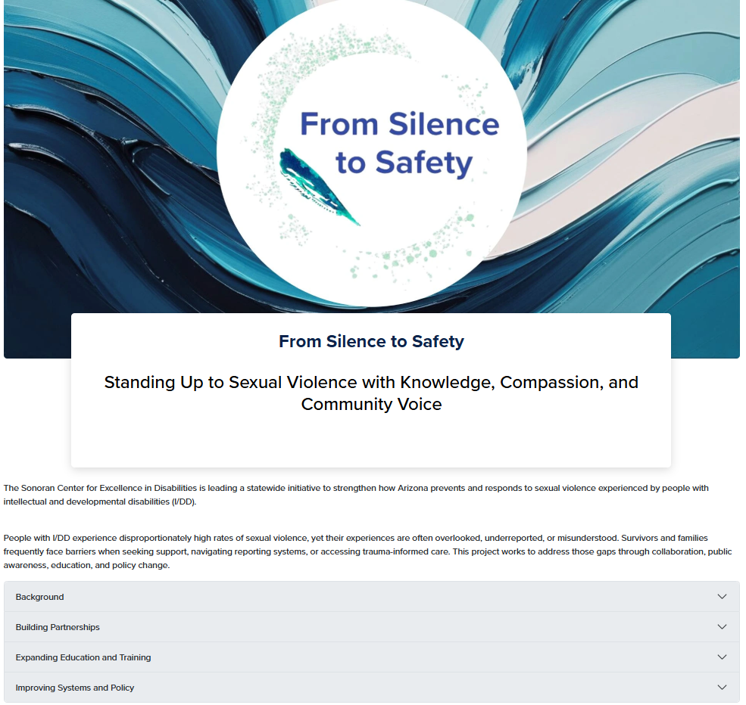
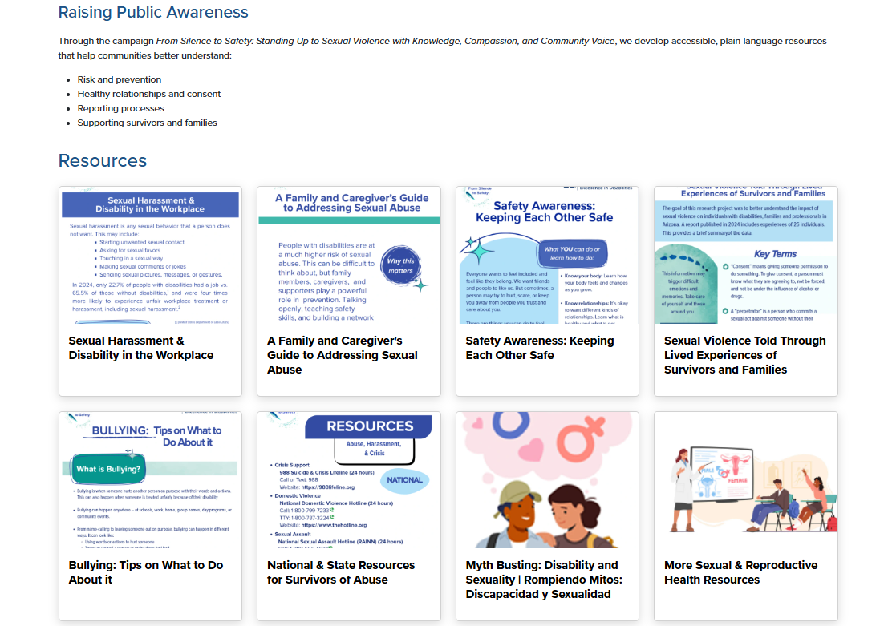
From Silence to Safety Website

Slide 24


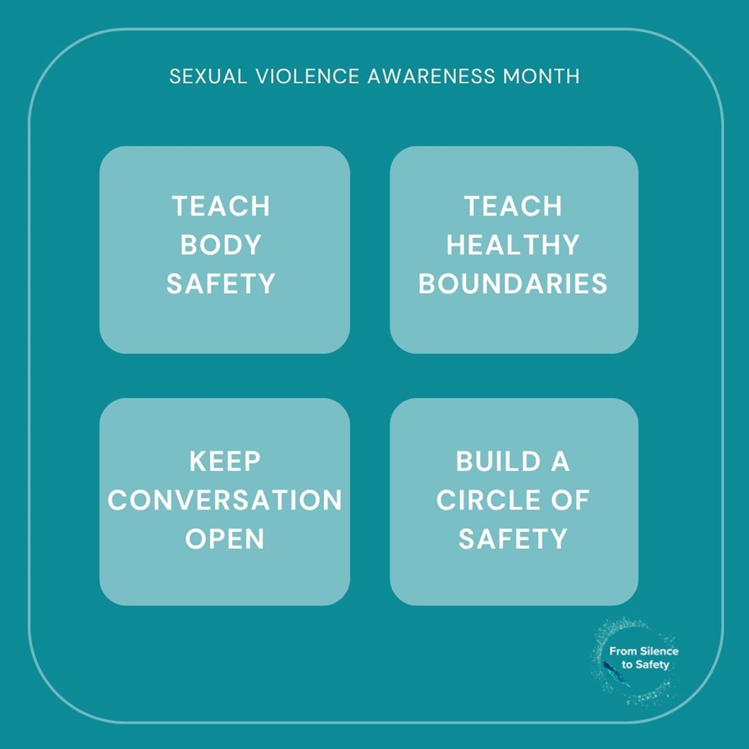
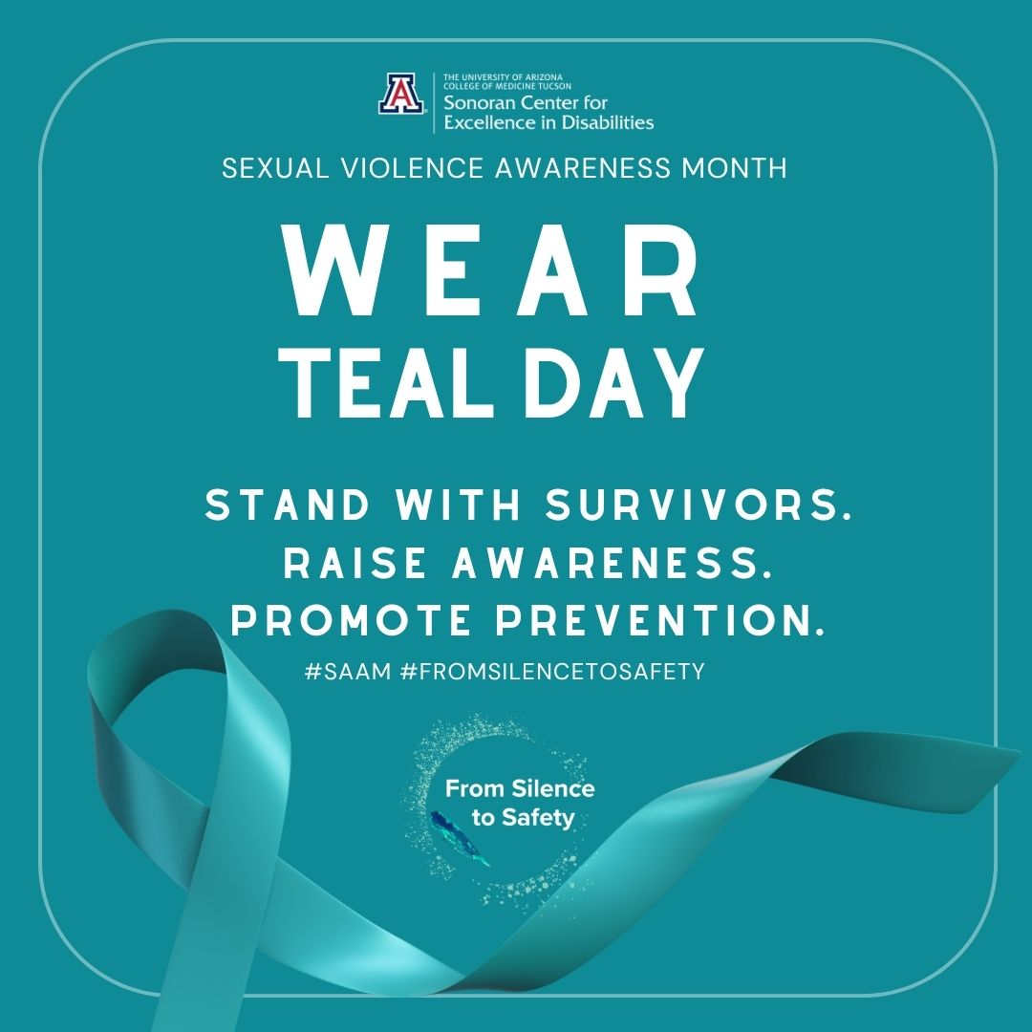
Social Media Toolkit
Social Media Toolkit
Zoom Background
Logos & Social Media Graphics
Social Media Planner
Includes captions and alt text

Slide 25
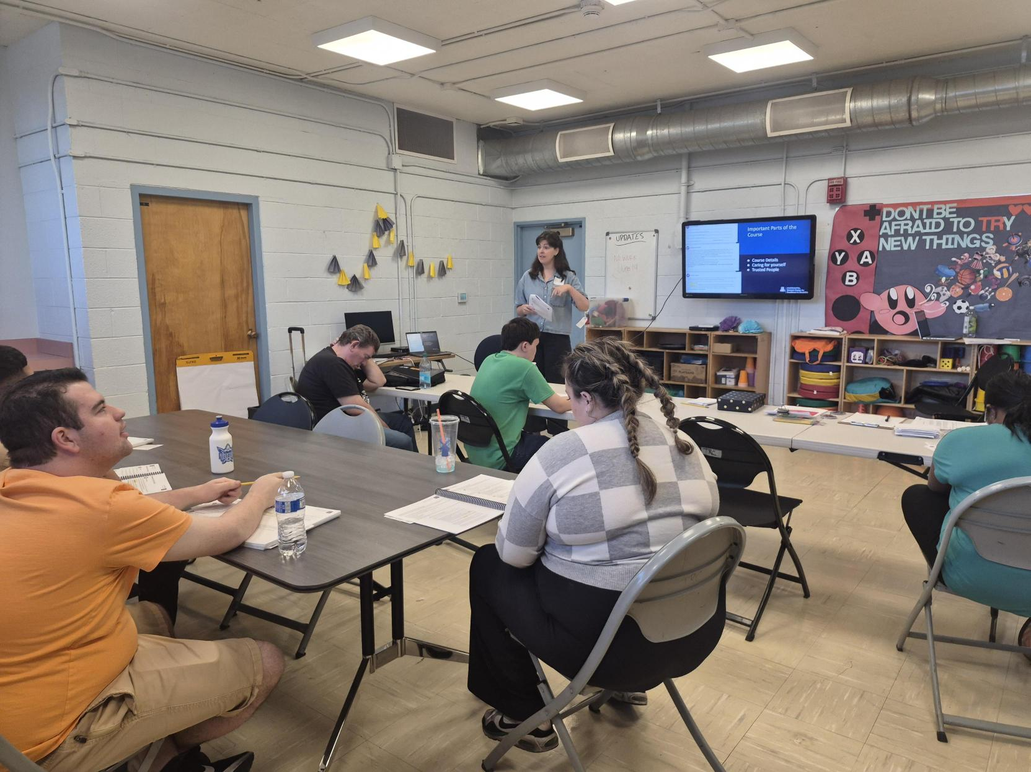

Understanding Me:
Healthy Relationships
8-week workshop series
Ages 16 to 22
Special Olympics curriculum

Slide 26

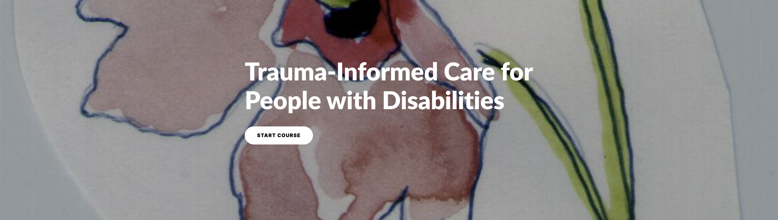
Online, Self-Paced Modules (Free)
Learning Objective:
Define sexual violence.
Summarize people's experiences with sexual violence from a recent research report.
Build awareness for the impact of trauma on survivors and families.
Learning Objective: (available soon)
Describe common Trauma experiences among people with I/DD.
Recognize behaviors in people with I/DD that may be related to trauma experiences.
Identify and reduce re-traumatization risks.
Describe trauma-informed care.
Demonstrate trauma-informed care.

Slide 27
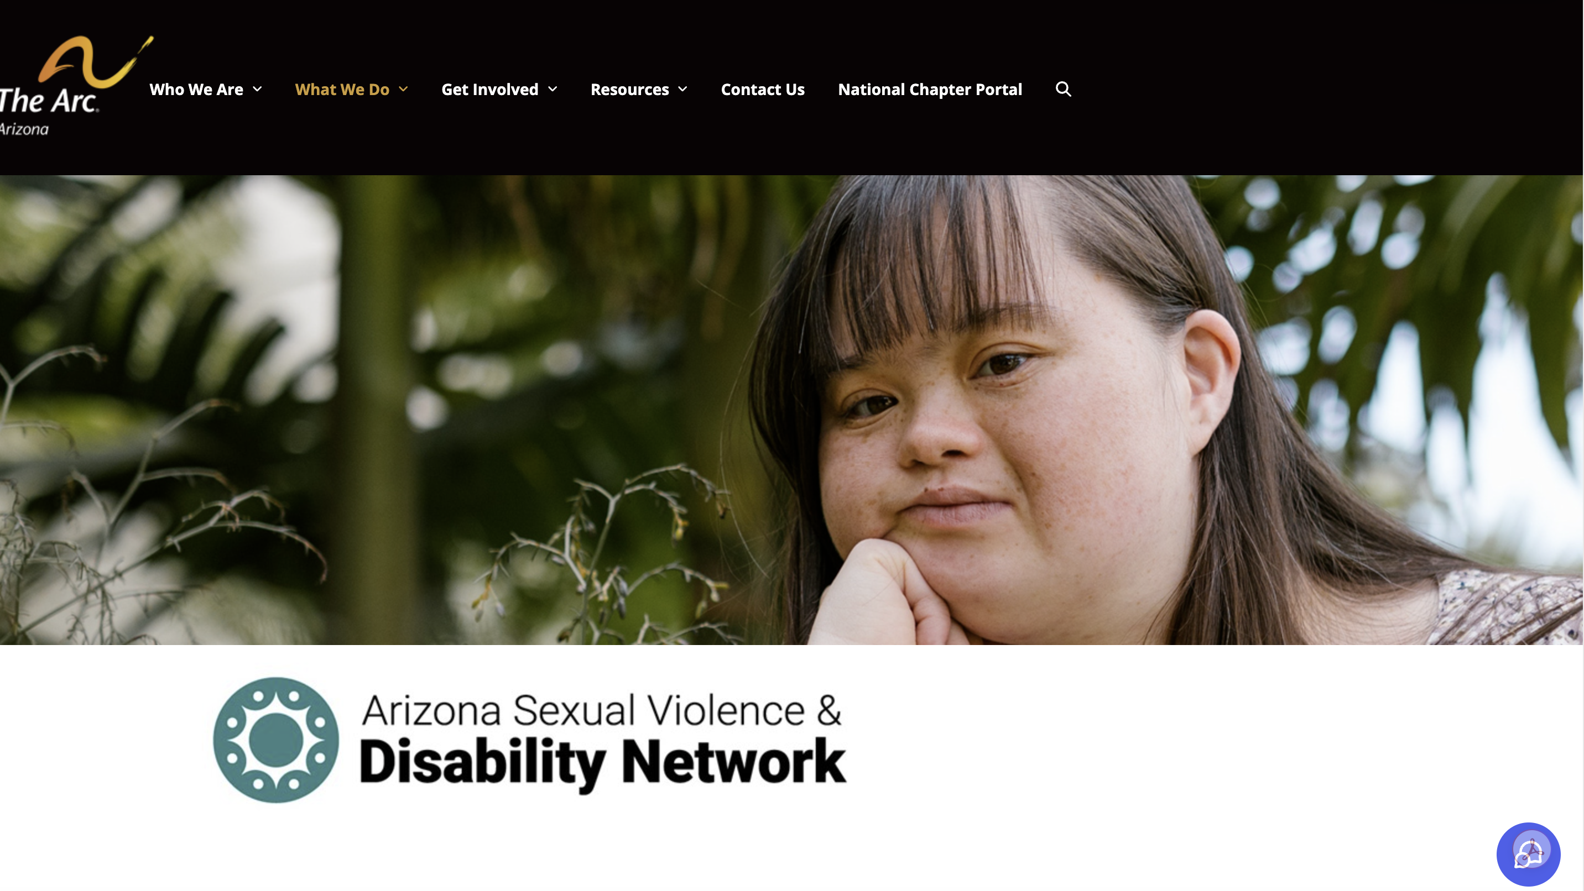

Slide 28

Arizona Sexual Violence & Disability Network
Our mission is to identify and respond to critical needs of individuals with IDD and other disabilities who face the greatest risk of sexual violence in Arizona. In our first two years, we focused our efforts on developing publications and easy-to-use resources, providing in-person and online webinars and training, and following key legislation to educate others on policy issues.
https://arcarizona.org/get-involved/arizona-sexual-violence-disability-network/
Notes:
Provide overview of the project

Slide 29

Arizona Sexual Violence & Disability Network
Criminal Justice
Training and Prevention
School Abuse Prevention Best Practices
Tribal Resources
Notes:
Provide overview of the workgroup activities and products.
Criminal Justice: We seek to better understand the criminal justice and law enforcement systems and how victims with disabilities – from first contact to interviewing to trial – are supported in order to determine how these systems can be strengthened. This Workgroup is in transition as it looks to recruit new leadership and will be working on its goals and objectives in the following year.
Training and Prevention: We collect, review, and maintain a list of current prevention and training curricula on the topic of sexual violence and IDD, while also collaborating to fill gaps in training and prevention resources throughout the state for families, Self-Advocates, medical professionals, providers, law enforcement, state agencies, and others.
School Abuse Prevention Best Practices: We research, develop, and publish guidelines regarding sexual abuse prevention and reporting that centers students with IDD. The group supports proactive measures that encourage healthy and safe relationships, self-advocacy, and awareness of sexual violence and other prevention-based topics for school-aged youth, school personnel, and families.
Tribal Resources: The Tribal Resources Workgroup seeks to create resources and increase accessibility to sexual assault violence resources for tribal communities and Native Americans with IDD. We will achieve this by connecting with key community partners​, utilizing prevention programs, increase education and awareness​, and offer health and wellness resources.

Slide 30
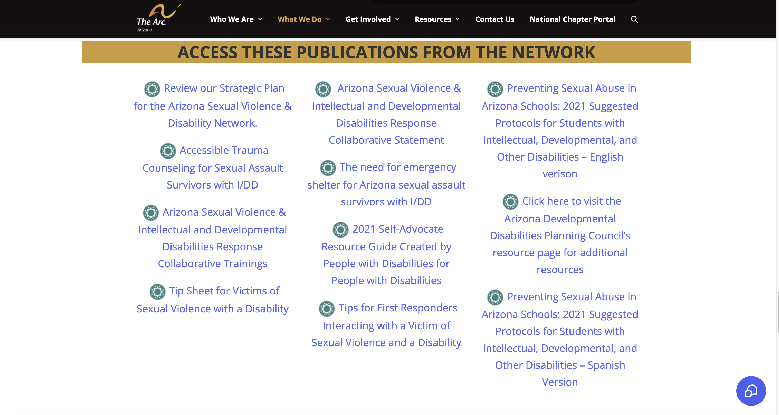

Slide 31
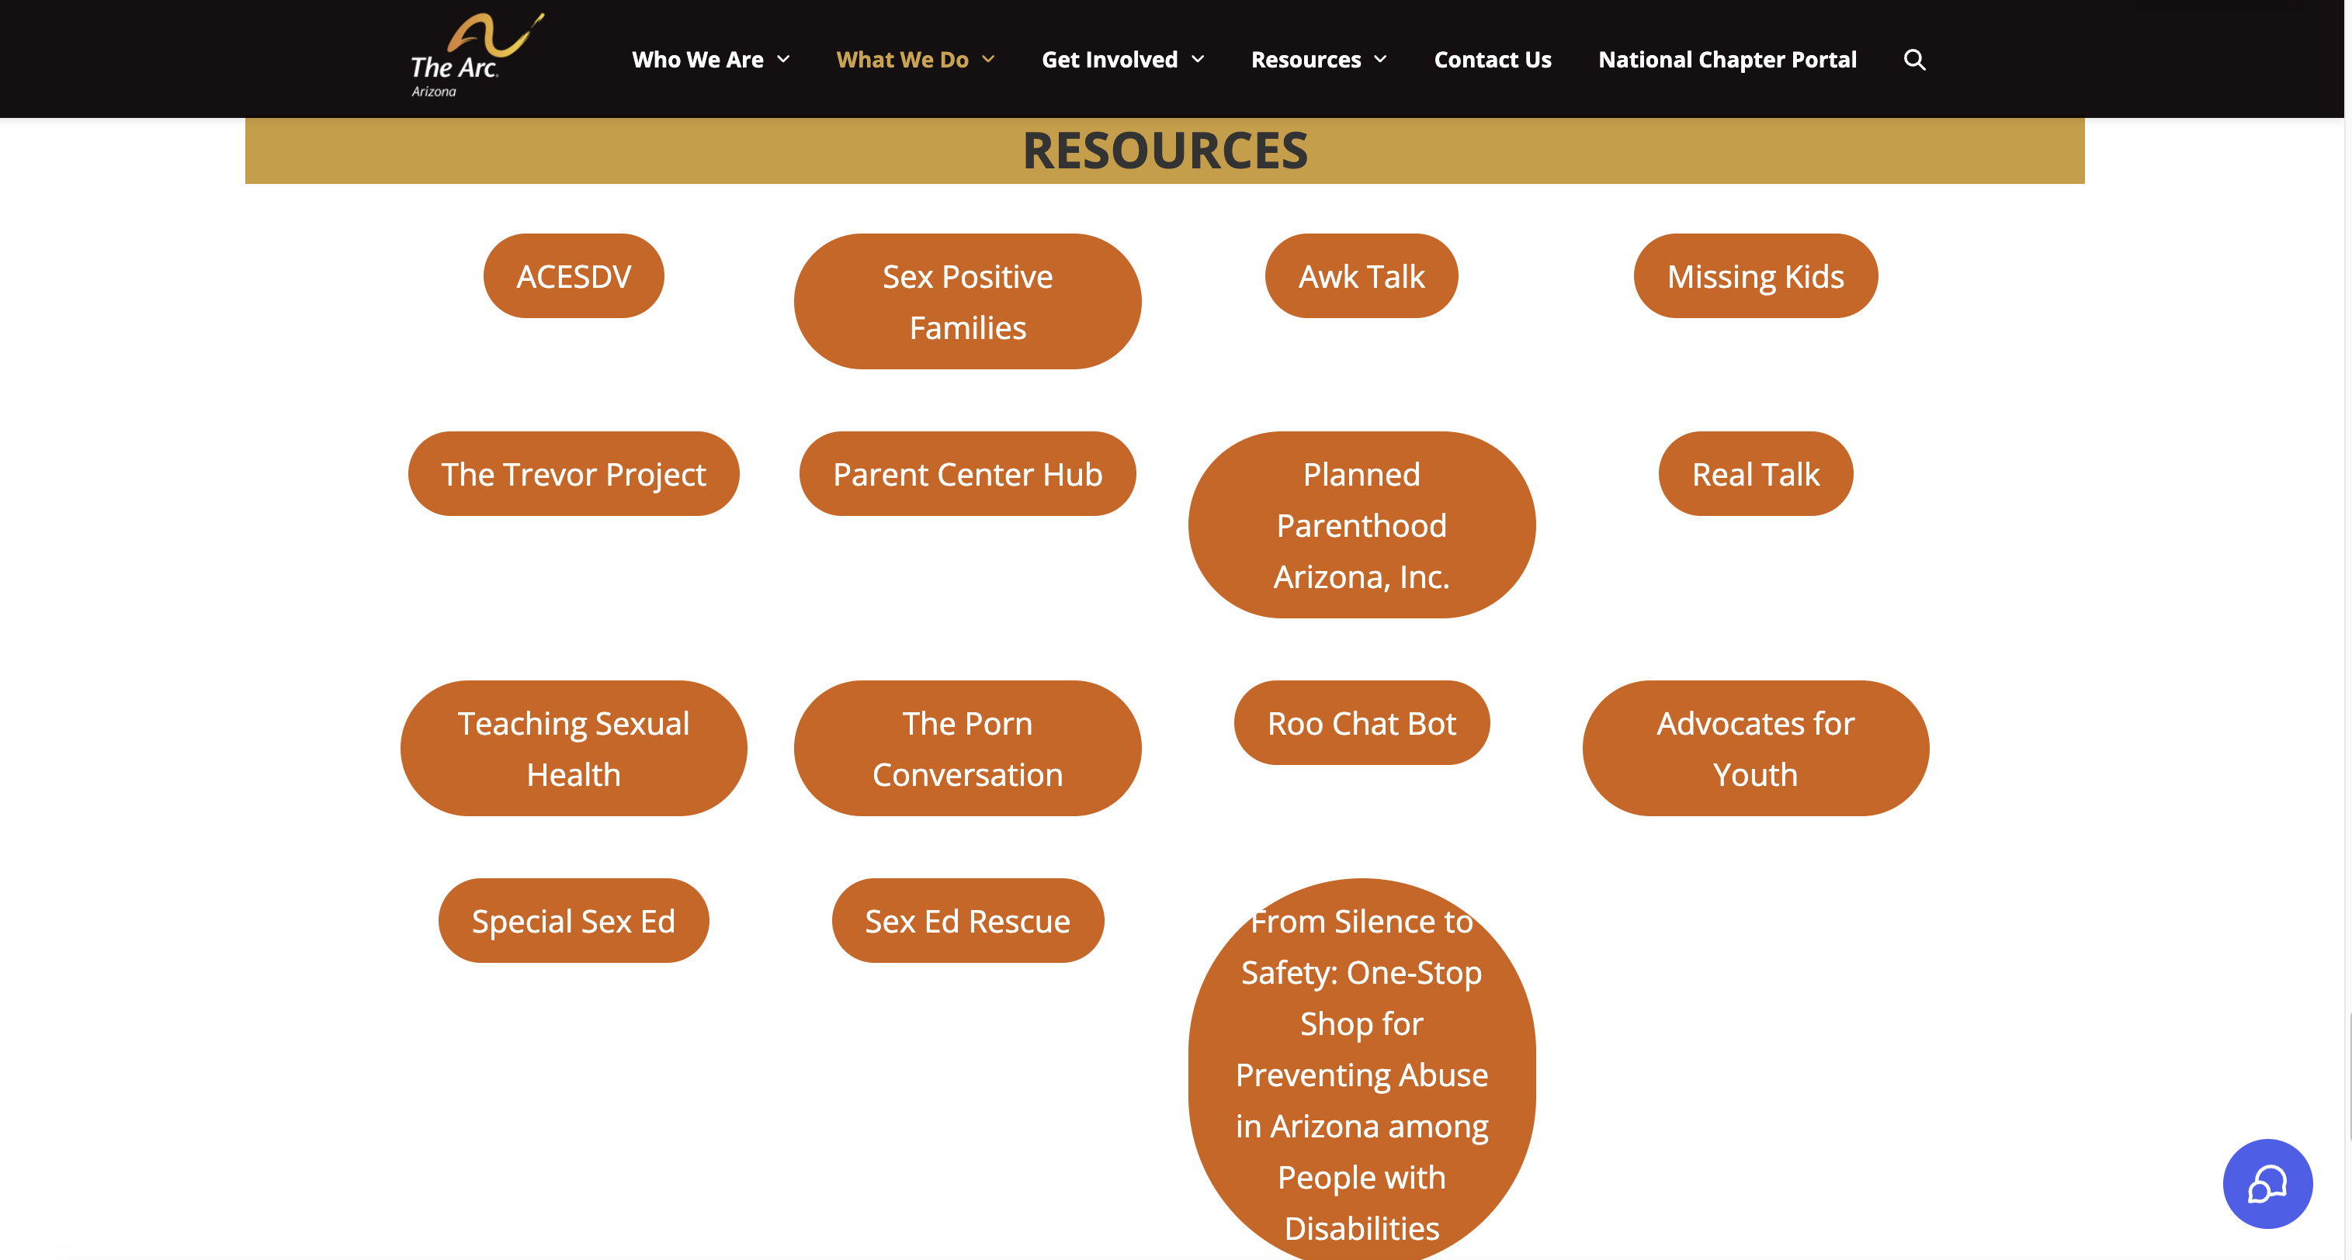

Slide 32



Questions?

Slide 33

Thank You!
For more information on From Silence to Safety:
Celina Urquidez – celinau@arizona.edu
Dr. Lynne Tomasa – ltomasa@arizona.edu
Gina Griffiths – griffiths@arizona.edu
Artwork by Bria Luu

