Slide 1

Disability & Abuse
Alex Schiwal, PhD

Slide 2
Abuse & Disability
Abuse can be physical, emotional, sexual, and financial and can also be categorized as neglect or exploitation.
Abuse is unwanted, harmful, and causes someone to be afraid
People can have many types of disabilities, oftentimes more than one:
  Intellectual or developmental disabilities
  Physical disabilities
  Sensory disability (vision, hearing)
  Traumatic Brain Injury
  Chronic illness
Depending on the type of disability, there are different risks, but all people with disabilities face a higher overall risk of abuse than non-disabled population

Slide 3
Why Disability is a target for abusers
People with disabilities are less likely to report or to be believed
People with disabilities can be more reliant on caregivers in isolated settings (group homes, day centers, etc.) where isolation is normalized and there is dependence on care providers (disabilityjustice.org, 2026)
Many people with disabilities are left out of education on sexuality, consent, and healthy relationships and may not know how to communicate what is happening to them (UNPF, 2018)
  Some people with disabilities may be tricked into thinking that something abusive is okay, if they have not been given information about what is healthy
Social stigma around disability and the belief that people with disabilities are less capable, easier to exploit, unaware = abusers think they have power over them

Slide 4
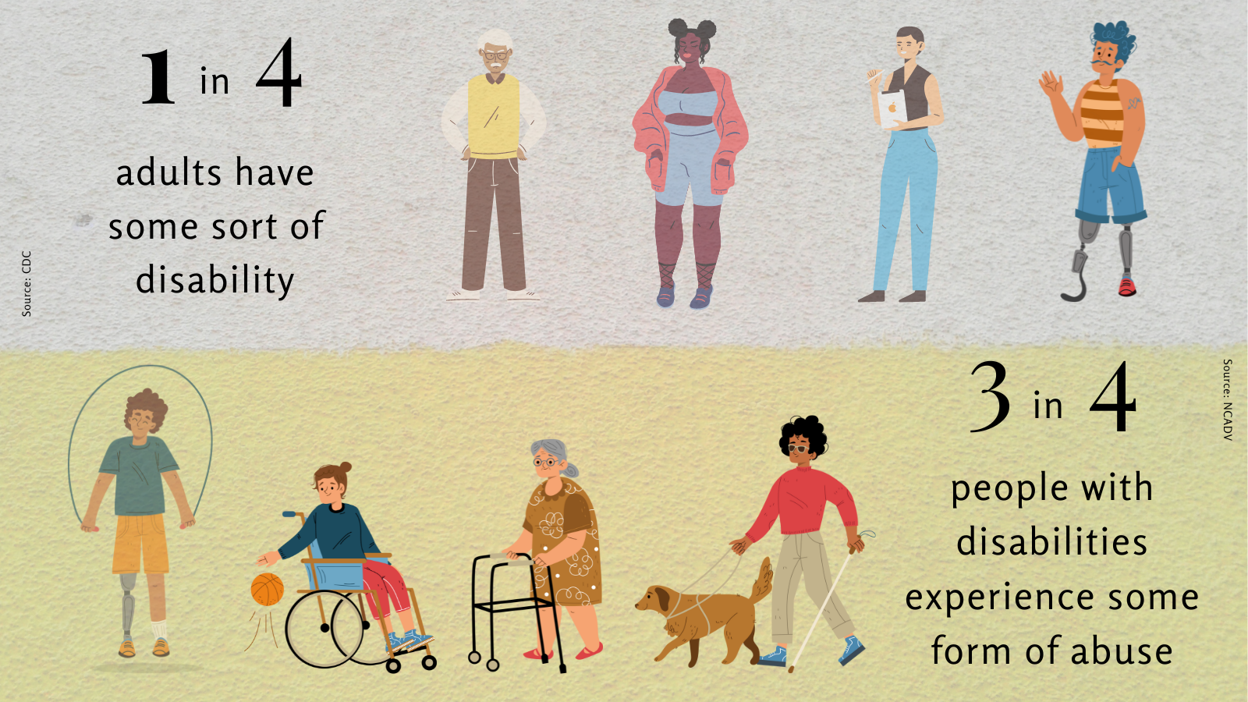
By the numbers
Disability is part of life, but abuse shouldn’t be

Slide 5
By the numbers
People with disabilities are almost 4x as likely to be victims of violent crimes as those without disabilities
Those with cognitive disabilities (using ACS definition - “serious difficulty in concentrating, remembering, or making decisions due to a physical, mental, or emotional condition”) had the highest rate of victimization
The reporting rate for sexual assault was nearly 50% less for people with disabilities, compared to those without disabilities
Individuals with disabilities are significantly more likely to be abused by a relative or caregiver
(Bureau of Justice Statistics, 2021)

Slide 6
By the numbers
97-99% of cases, individuals with disabilities were abused by someone they knew - intimate partner, family member, caregiver, or health aide (YWCA)
Most cases of abuse against individuals with disabilities are not reported, and of those that are, only 5% are prosecuted (compared to 70% in non-disabled pop., NCADV; DVSN, 2023)
DV/crisis shelters may not be accessible, and only 35% of shelters have disability awareness training for their staff
Only16% of DV/crisis shelters have a dedicated staff person to deliver services to those with disabilities (NCADV)
Lack of training overall for professionals

Slide 7
By the numbers – Needs assessment
Conducted in Utah in 2022-2023, Adults with Disability = 18, Family Members/Legal Guardians = 44, Professionals = 47
Received previous information/training: Professionals: 37%, Family/Guardian: 14%, Adults with Disabilities: 50%* (*only 7 participants)
Professionals received more information on all topics than family members or individuals
Less than half of all participants knew where to find information on these topics
Barriers mentioned included:
  Concerns about “morality” and feeling uncomfortable discussing these topics
  Stigma and attitudes towards people with disabilities are infantilizing
  Lack of understanding of the importance and need for training and resources on these topics

Slide 8
What can we do?
Understanding/identifying signs of abuse, neglect, and exploitation in populations with disabilities
Education and training (for all members of the community)
  Resource sharing & empowerment
Change agency culture, plan for and integrate disability into facilities, programs, and staff training
Ask questions, use your professional networks
Understand your roles, responsibilities, and what resources are available
*Future and past DHR ECHO Sessions will cover all these topics in more detail than the following slides

Slide 9
What can we do? Know the signs
Sudden changes in attitude, appearance, or behavior
Comments about potentially concerning interactions
Fear or agitation at the mention/or in presence of a particular person
Controlling behavior on the part of a caregiver, partner, or guardian
Signs of neglect or abuse (missing medications, adaptive equipment, communication devices)
Physical signs
Financial exploitation – suspicious added names on accounts, loss of funds/possessions, lack of adequate care, changes to balances or persons on accounts

Slide 10
What can we do? Educate & Train
Treat individuals with disabilities with respect, don’t infantilize them, or deprive them of information
  Advocate with caregivers to ensure they have access to information
A disability can be acquired by any person at any time in their life; professionals should be trained to understand how disability may impact people in their field of work
Share resources with individuals & caregivers about abuse prevention
Attend trainings & share with others in your network – (more shared in discussions and sent out after this training)
TETONS - a comprehensive class mapping a road to relationships, sexuality and self-determination for individuals with disabilities. Utah Parent Center, in partnership with Utah Developmental Disabilities Council, have curated this unique material to meet the needs of self-advocates 13 years of age and up.
Online Self-Paced Training: Accessible Education, Planned Parenthood
As leader in preventative health and education, Planned Parenthood offers multiple, free, and self-paced courses about abuse prevention, healthy relationships, consent, appropriate behaviors for individuals with disabilities, caregivers, and professionals.

Slide 11
What can we do? Focus on Disability
Change agency culture – if your organization doesn’t have a focus on disability, you can advocate for this to be integrated within your workplace
Plan for and integrate disability into:
  Facilities: your building, classes, resources should be accessible
  Programs: ensure that program content is relevant or considers disabilities
  Staff training: training staff on disabilities at a 101-level, profession/topic-specific trainings, general accessibility trainings for staff
Increase knowledge across the workplace & reduce stigma around disability
Better prepared to support clients with disabilities

Slide 12
What can we do? Know your role
Are you a mandatory reporter? Depends on your job/state
  Someone who is legally required to make a report about suspected abuse
  In most cases, you will be – as the laws around “vulnerable adults” vary widely, but if you suspect something reportable happened/is happening, you can make a report to the appropriate channels (state dependent)
When working with individuals with disabilities (or anyone else), be transparent about your role, what will happen, and ensure them they are not in trouble/at fault
Fact sheets: Mandatory Reporting, Responding to a Disclosure
DHR ECHO sessions – Working with APS, Safety Planning

Slide 13
Questions?
Resources
Past DHR ECHOs
USU DHR Resource Page
https://www.thehotline.org/resources/abuse-in-disability-communities/
https://www.disabilityrightssc.org/abuse-neglect-exploitation-definitions-warning-signs-2/
https://www.niwrc.org/sites/default/files/images/resource/fact_sheet_pdfs.pdf
https://bjs.ojp.gov/content/pub/pdf/capd0919st.pdf
http://www.calcasa.org/wp-content/uploads/files/angie-blumel-advocate-guide-safety-planning-final-printer.pdf
alex.schiwal@usu.edu

